Slide 1
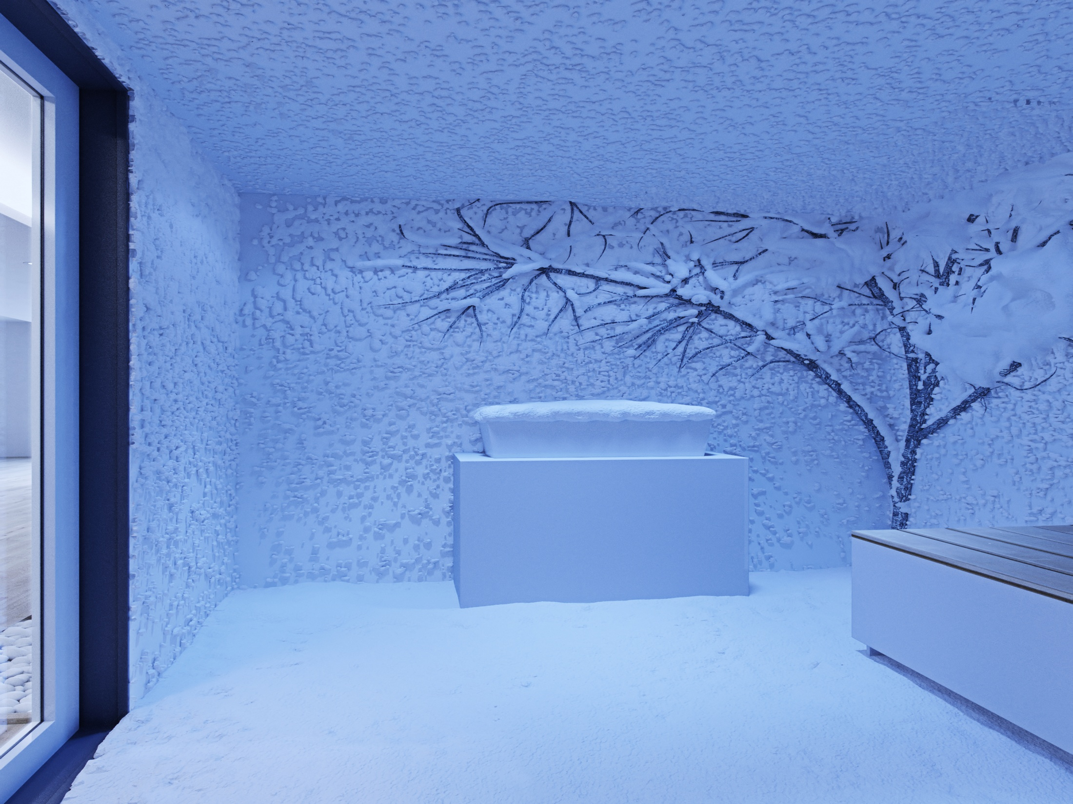
AREASANA ® “SNOW FOR YOUR HEALTH”
Snow rooms
Brought to you by
DATTATREYA INC.

Slide 2
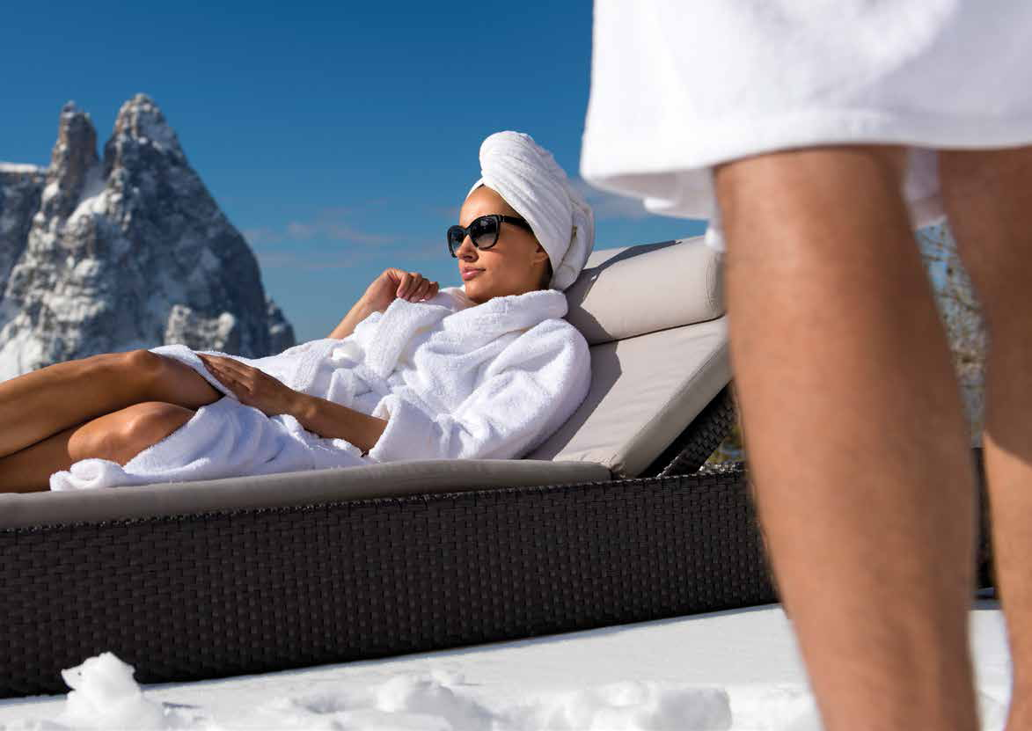
SNOW is loved by everyone!
AREASANA Snow Chambers gives the SAME EXPERIENCE

Slide 3
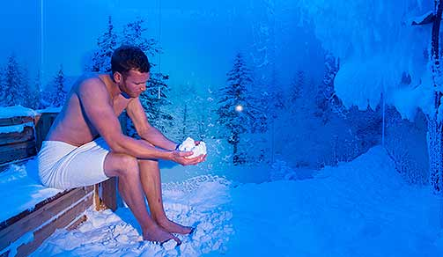
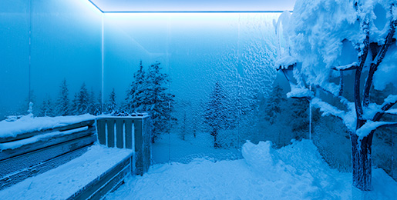

Slide 4
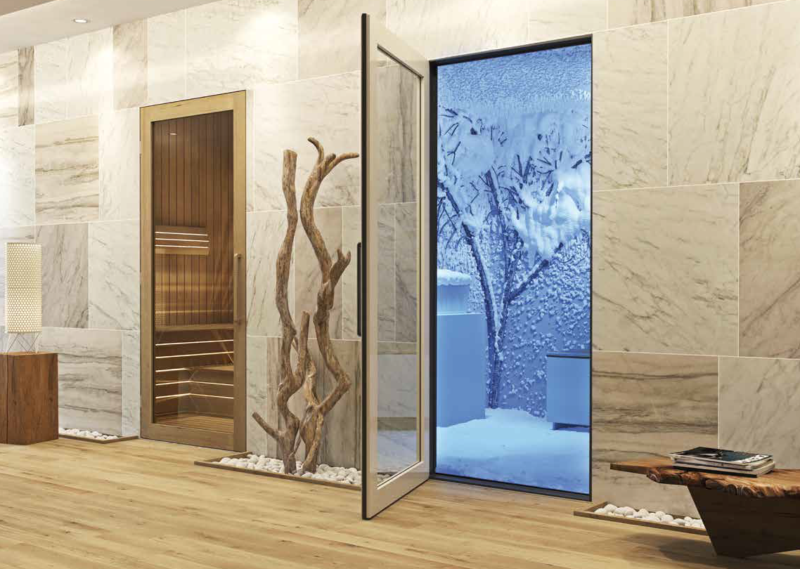
The conventional method suggests a cold water shower
after the sauna bath.
Scientifically proven- cold dry snow is more beneficial
after the sauna bath.

Slide 5
Health Benefits
Stimulates metabolism, increases blood circulation in the muscles and skin and strengthens the immunity.

Slide 6
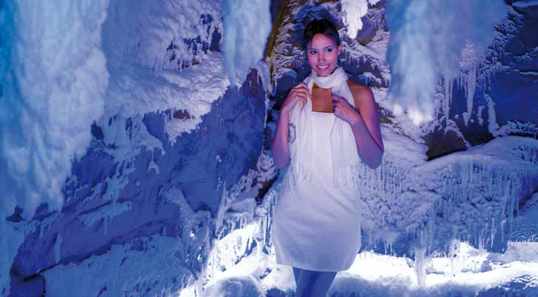
Aesthetics
The influence of warmth and cold on our skin leads to detoxification of the system, improved skin tone and can also reduce wrinkles.

Slide 7
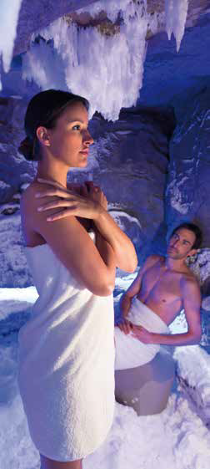
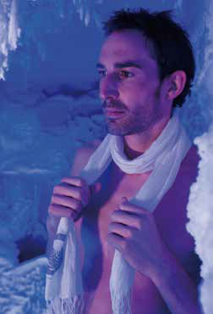
Well Being
Relaxing, revitalizing, stress reducing effects, and endorphin release beneficial for pain receptors

Slide 8
Depending upon the needs of your wellness area, AREASANA is available in various sizes.

Slide 9
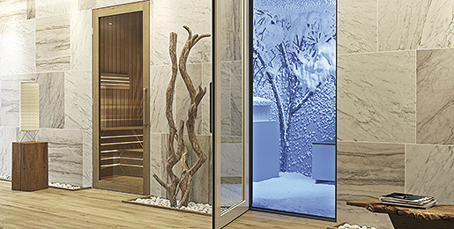
Each AREASANA snow room can be influenced by your design wishes.

Slide 10
The snow inside the AREASANA snow room is made by using drinking water and air.

Slide 11
The patented AREASANA package consists of:
The snow room
Technical room.
AREASANA accessories.
Specialized interiors.

Slide 12
Requirements of AREASANA
LITTLE AREASANA® | AREASANA® GRANDE
Resorts, Villas and Gymnasiums | 5 Star Hotels and Gymnasiums
6 sq m. snow room 8 sq m. technical room | 9/12/15 sq m. snow room 10.5 sq m. technical room
Drinking Water Connections ( 30 liter /hour) | Drinking Water Connections ( 30 liter /hour)
Electrical Connections ( 11kW, 380 V, 16 A- 5x6 sq mm cable) | Electrical Connections ( 18kW, 380 V, 27 A- 5x6 sq mm cable)

Slide 13
Past Projects
Le Meridien – Dubai
Radisson Sochi – Russia
MGM Grand Hotel –China
Jumeirah Zabeel Saray – Dubai
Abama Resort – Spain
Rixos Belek – Turkey
Rixos Royal Spa Club – Moscow
Belavitta Spa – Italy
Hotel Cornelia – Turkey
Many more Private Villas, Resorts and Palaces of Kings and Queens around the world

Slide 14
THANK YOU
For further details contact:
Dattatreya INC.
(O): 0265 2974338
(M): 8141673329
info1@dattatreyainc.com
www.dattatreyainc.com

