Slide 1


WELCOME TO
MTS PERFORATOR GMBH
Titel der Veranstaltung
Datum
Geschäftsführer:
Carsten Weiß
Gilbert Kimpel
Johann-Christian v. Behr
Hauptsitz Walkenried:
Bei dem Gerichte
37445 Walkenried
Tel. +49 5525 201 - 0
Fax +49 5525 201 – 48
Zweigniederlassung Valluhn:
Am Heisterbusch 18 a
19246 Valluhn
Tel. +49 38851 327 - 0
Fax +49 38851 327 – 10
info@mtsperforator.de
www.mtsperforator.de

Slide 2

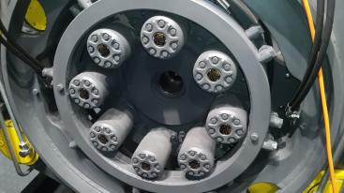
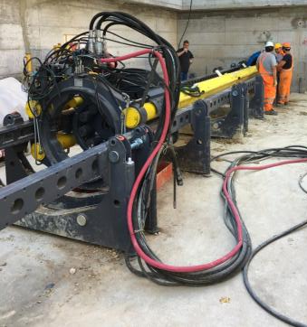
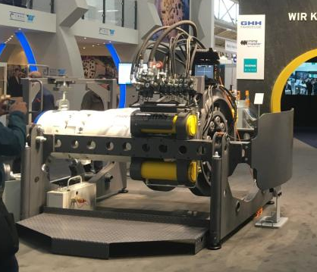
PBA 205

Slide 3




comparison PBA205 / PBA155/200
PBA 205
PBA 155/200
2m tools in 3,2m round shaft
Full automatic operable by micro tunneling
power pack container and laser guidance
Available with long stroke thrust cylinders
to use in Combination with extension frame
and pipes up to 12m length.
Available for pipes in Ø 1220 mm

Slide 4

comparison PBA205 / PBA155/200

Slide 5
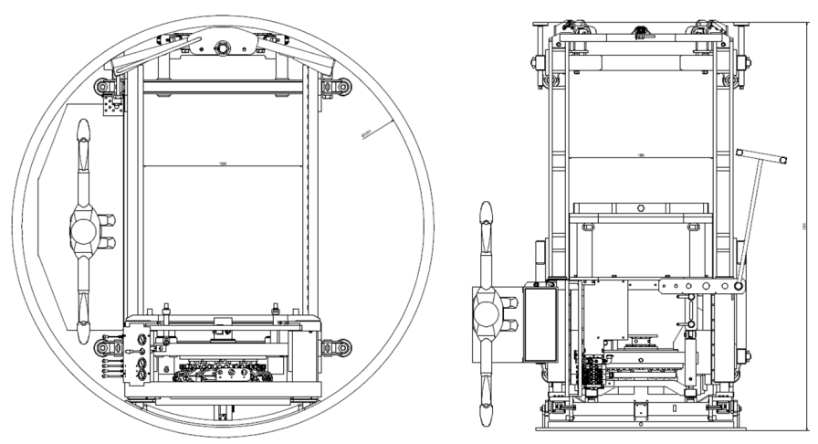
comparison PBA205 / PBA155/200
PBA205 2m tools in 3,2m shaft
PBA155 1m tools in 3,2m shaft

Slide 6
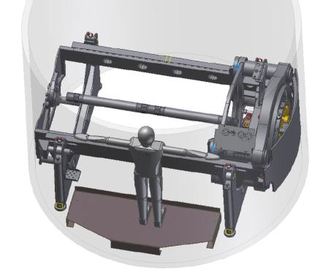
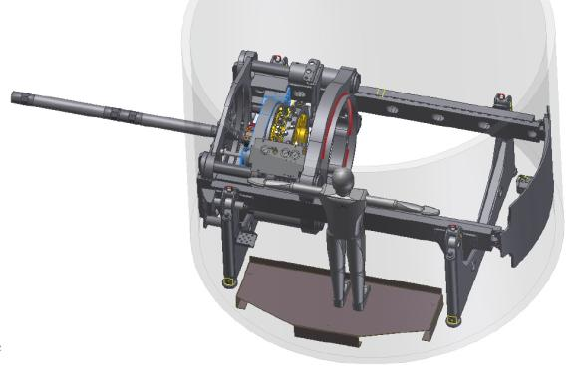
PBA205 / 3,2m shaft / pilot rod 2m length
Piloting with PBA 205 in 3,2m shaft
Piloting with 2m pilot rods

Slide 7
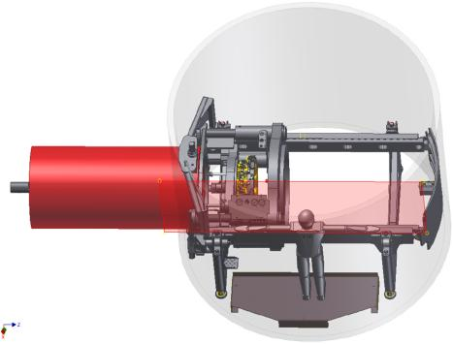
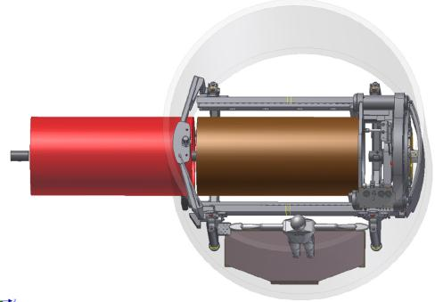
PBA205 / 3,2m shaft / pipe length 2m

Slide 8
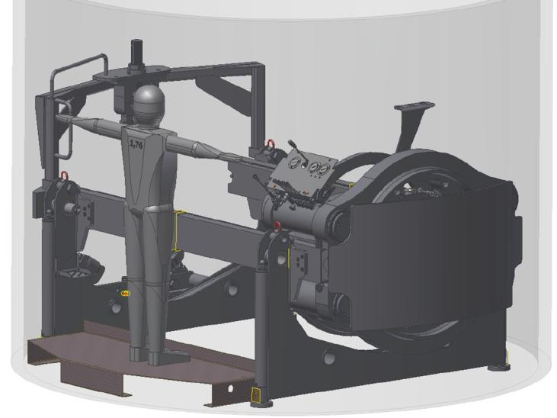
PBA205 / 3,2m shaft / pipe length 2m
Slewing hydraulic hose connection

Slide 9
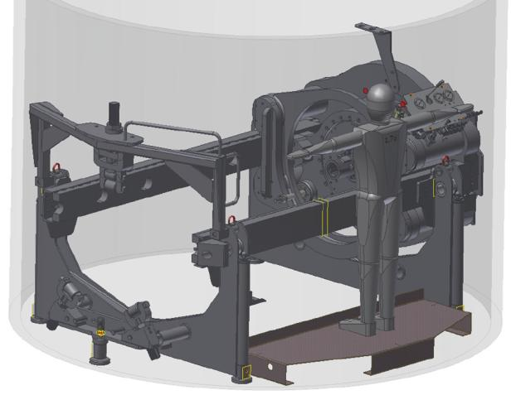
PBA205 / 3,2m shaft / pipe length 2m
Pipe guidance for ø 219mm – 1050mm
Pipe guidance for ø 219mm – 1050mm

Slide 10
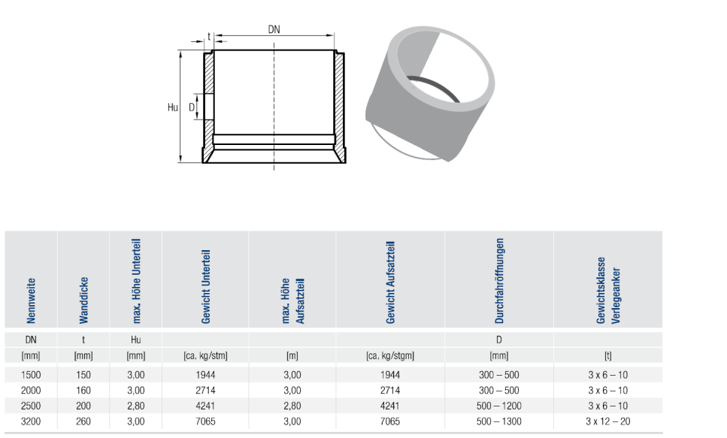
Round shaft 3,2 m

Slide 11
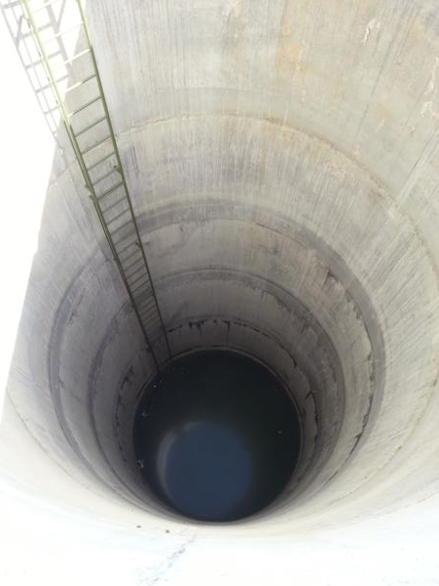
Round shaft 3,2 m

Slide 12
PBA205 LH

Slide 13
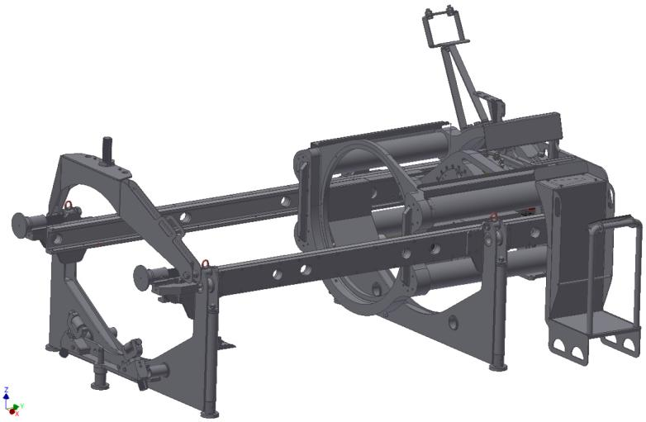
PBA205 LH

Slide 14
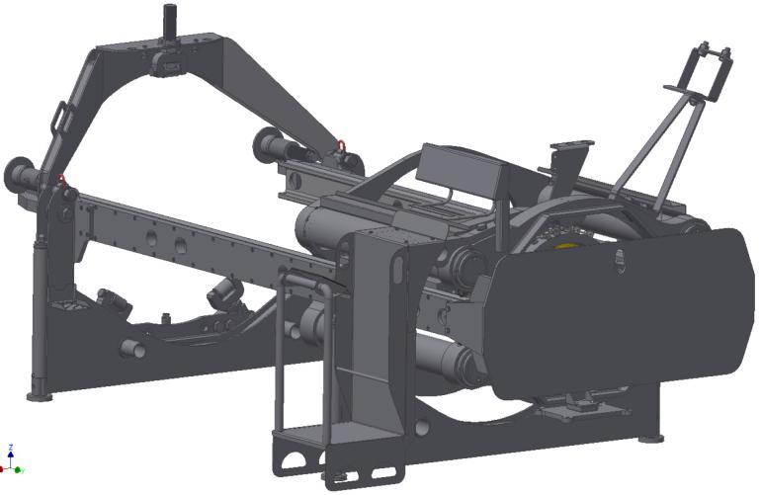
PBA205 LH

Slide 15
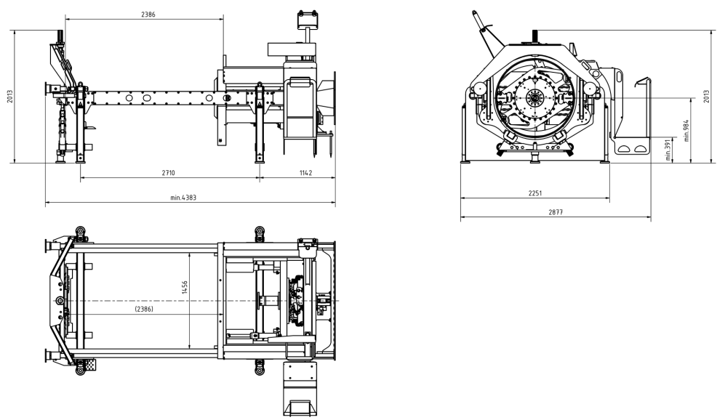
PBA205 LH special design with stroke 1230 mm and pipe Ø 1220 mm

Slide 16
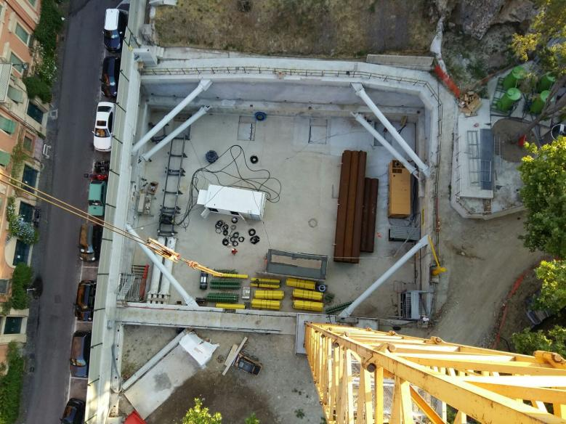
PBA205 job site PATO / Italy

Slide 17
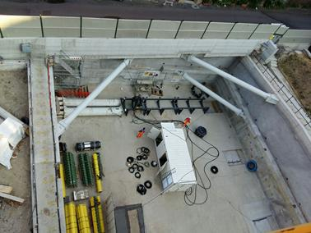
PBA205 job site PATO / Italy

Slide 18
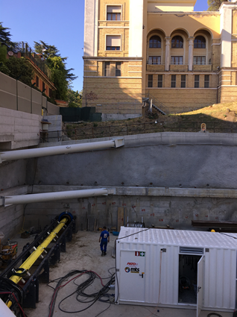
PBA205 job site PATO / Italy

Slide 19
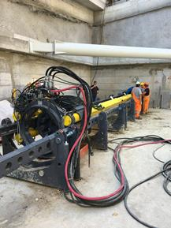
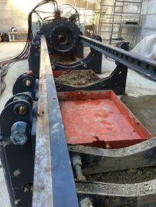
PBA205 job site PATO / Italy

Slide 20
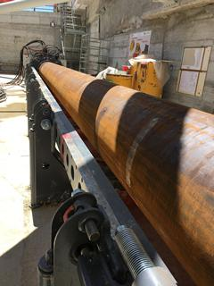
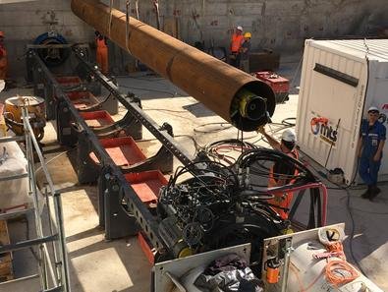
PBA205 job site PATO / Italy

Slide 21
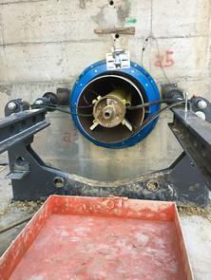
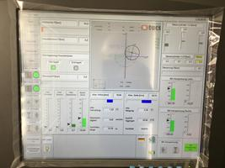
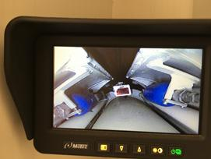
PBA205 job site PATO / Italy

Slide 22
THANK YOU FOR YOUR
KIND ATTENTION
Geschäftsführer:
Carsten Weiß
Gilbert Kimpel
Johann-Christian v. Behr
Hauptsitz Walkenried:
Bei dem Gerichte
37445 Walkenried
Tel. +49 5525 201 - 0
Fax +49 5525 201 – 48
Zweigniederlassung Valluhn:
Am Heisterbusch 18 a
19246 Valluhn
Tel. +49 38851 327 - 0
Fax +49 38851 327 – 10
info@mtsperforator.de
www.mtsperforator.de

