Slide 1
S6 SNOMAKING SYSTEM

Slide 2
S6 for sKI domes / Gaming Zone
S6 patented system with quick crystallization of snow particles
S6 highest productivity in indoor snow system - 1m3/hr
Produces snow at - 2°C temperature: snowdome does not have to be cooled down to - 8°C
Centralized or decentralized snow production possible
Daily snow production up to 20 hours per day
Dedicated internal heat exchanger minimizing the humidity load of ambient air conditioning

Slide 3
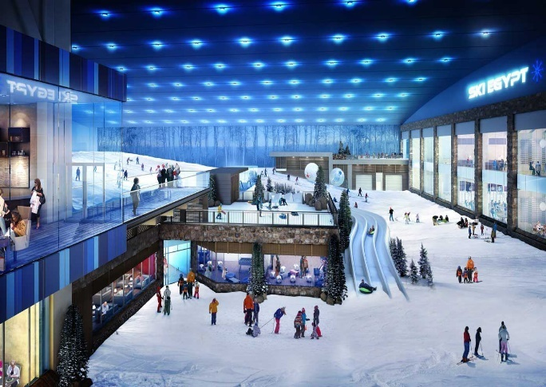
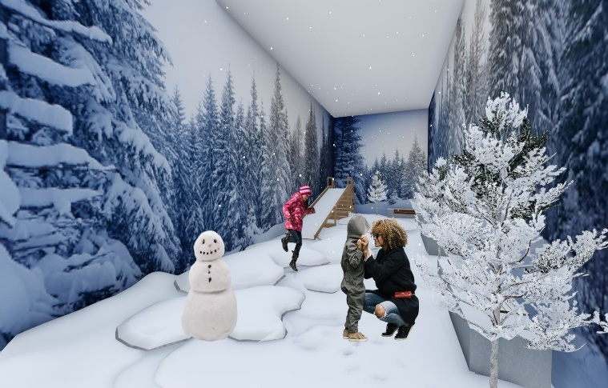
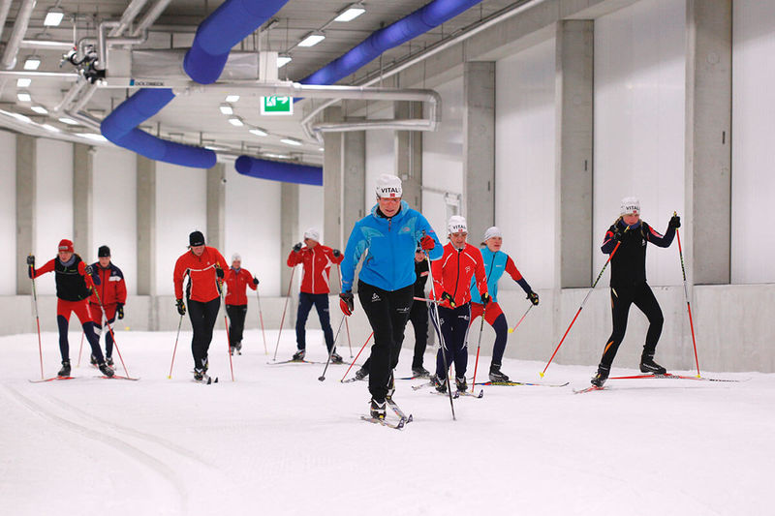
S6 for sKI domes
Ski Domes Fun Parks / Play Ground Training Centers

Slide 4
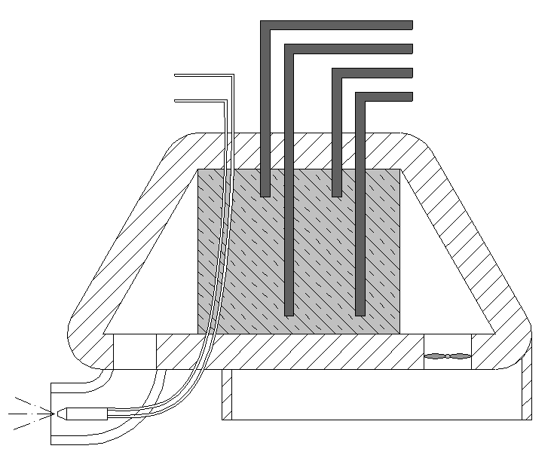
S6 snow making S – SYSTEM SUMMARY
Warm brine
Pressured air
Cold brine
Water
Integrated heat exchanger to cool down air for snowmaking
Item | Description
1 | Water and air supply connections
2 | Cold and warm brine connections
3 | Electric switch cabinet
4 | Indor Snow nozzles
5 | Snow sperator
6 | Machine mountings for installation
Cold air flow for quick crystallization of nucleids
Air insipiration
Ventilator
Snow nozzle producing nucleids out of air and water

Slide 5
2. USP‘S and MAIN ADVANTAGES IN COMPARISON

Slide 6
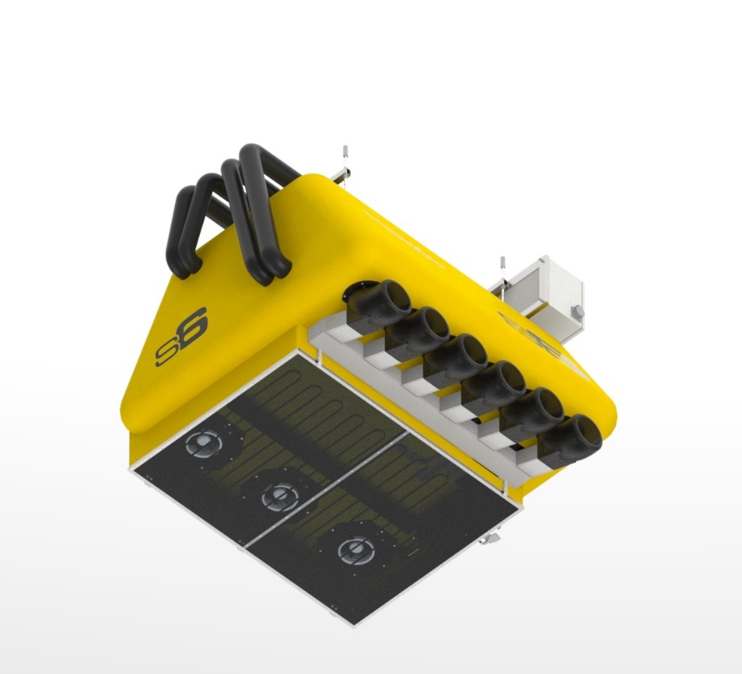
S6 – AC TEMPERATURE INDEPENDENT SYSTEM
STEP 2: The inspired air is cooled further down by the heat exchanger which generates a cold air flow.
STEP 3: By doing so the cooled air of the snowdome is not charged with energy (is not warmed up).
A clear view in the snowdome is guaranteed.
No air dehumidification system needed- no doors need to be opened to release humidity which is created by snow production
No impact on the snow dome temperature
Supports air conditioning system with negative temperature output of the snow making system
Independent from outside temperatures, snow can be produced during whatever season and outside temperature
Automated system which starts snow production only at the measured internal air temperatures-> guarantees perfect conditions for snow production
STEP1: Air inspiration: the cooled down air of the snowdome is inspired (-2°C) and transported to the heat exchanger thanks to the aerodynamic construction

Slide 7
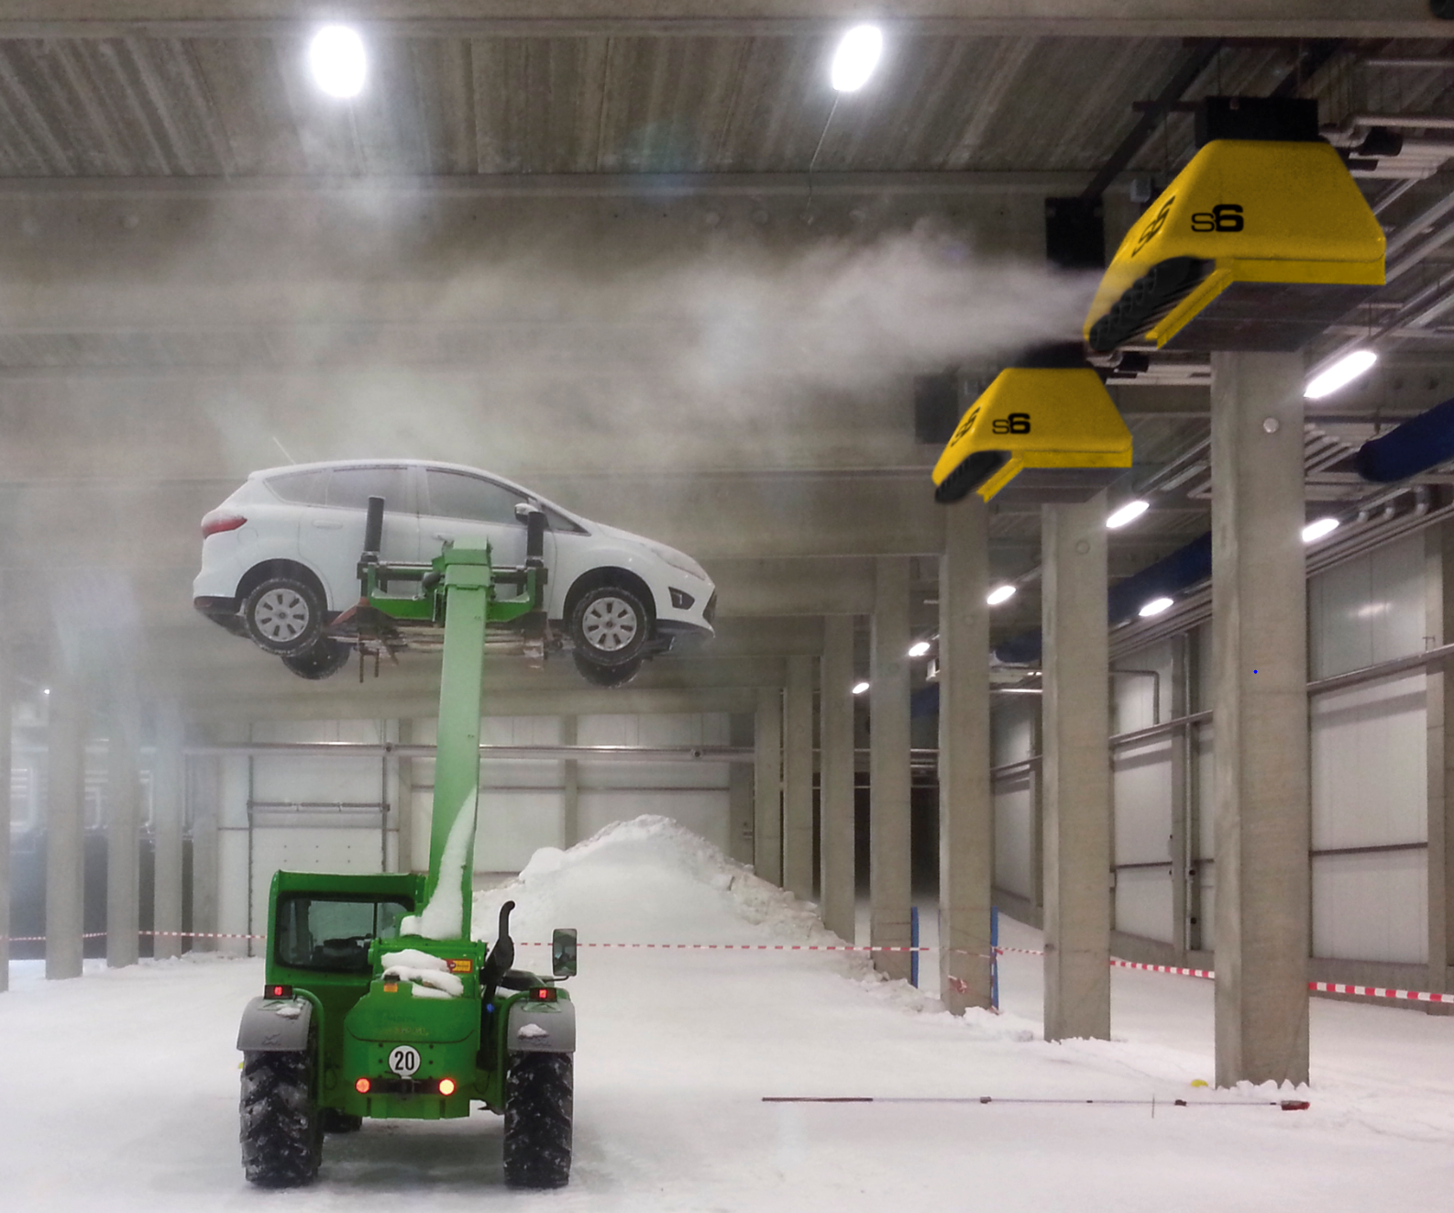
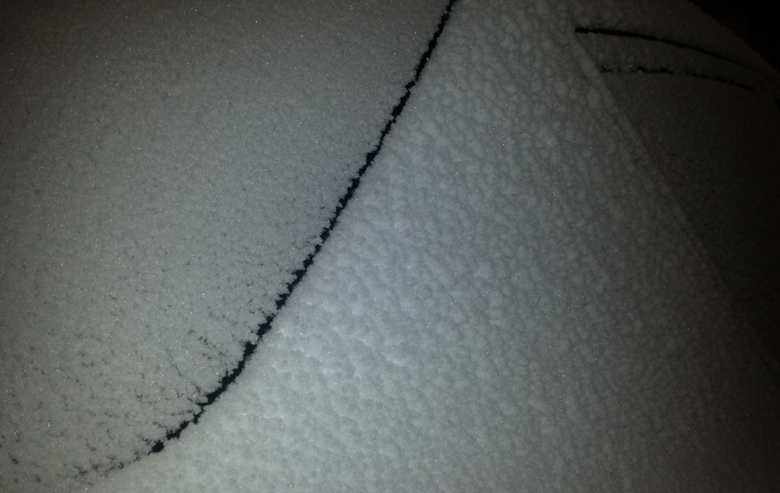
S6 - QUICK CRYSTALLIZATION FOR POWDER SNOW
Snow particles produced in cold air flow guarantee quick crystallization of snow particles and less release of humidity to the surrounding , which otherwise would influence negatively the comfortable climate in the snowdome
In a very short distance the S6 produces already real POWDER SNOW
Whereas other systems might need a very long way for the snow fall and a longer process time to complete snow crystal formation.
The S6 works perfectly also on the top of the slopes where the snowdome ceiling is not so high.
With other systems the snow groomers have to transport huge snow amounts to the top of the slopes, with the S6 a sustainable use of snow groomers is guaranteed.
The pictures proof the powder snow quality within a very short distance.

Slide 8
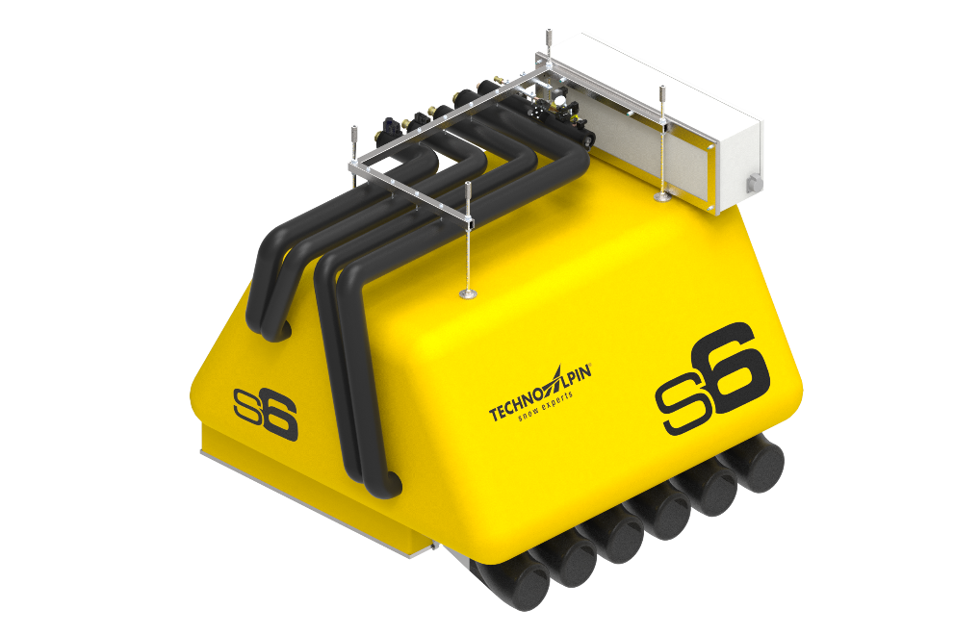
LONG LASTING POWDER SNOW PARTICLES
S6 required Installation height for powder snow production
cieling
Thanks to the integrated cold air flow crystalls are formed much quicker
4,5 m
Minimum distance from ground to machine

Slide 9
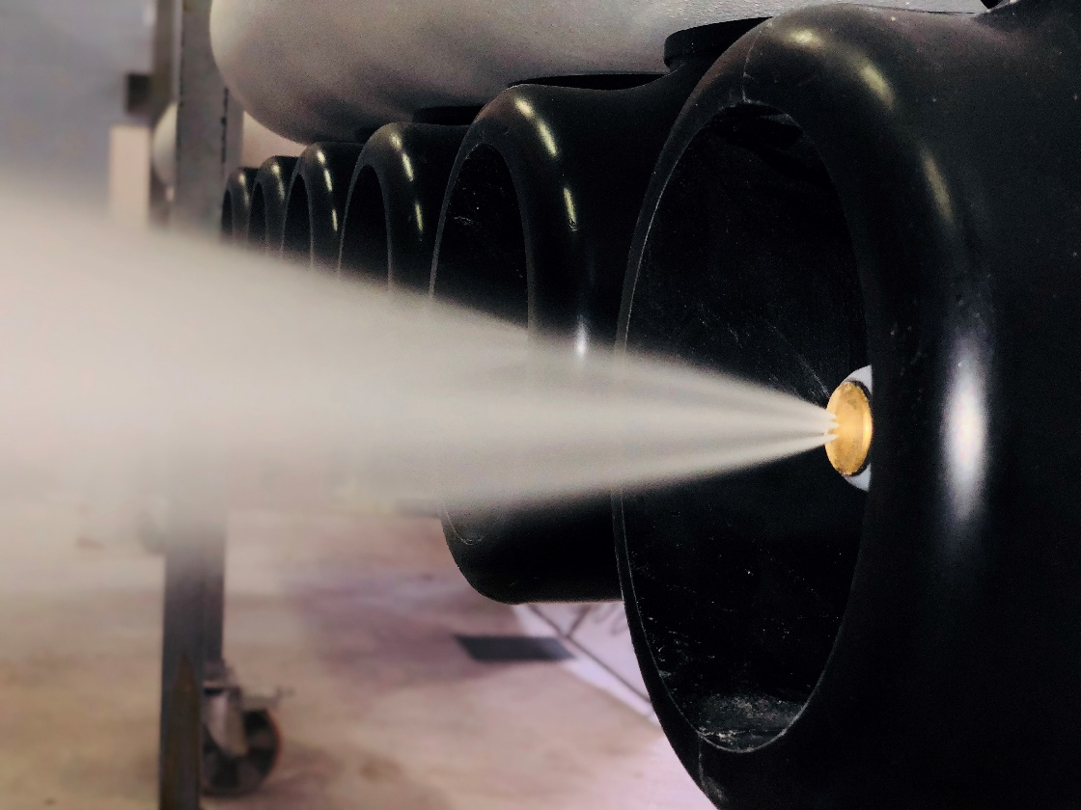
LONG LASTING POWDER SNOW PARTICLES
The high quality snow production guarantees a long lasting snow.
The complete amount of snow NEVER has to be exchanged completely!
No waste of water resources. With other systems the snow has to be renewed completely and demands a shut down of the snowdome.
Because snow is consumed, a fresh white powder snow layer can be reproduced every day.

Slide 10
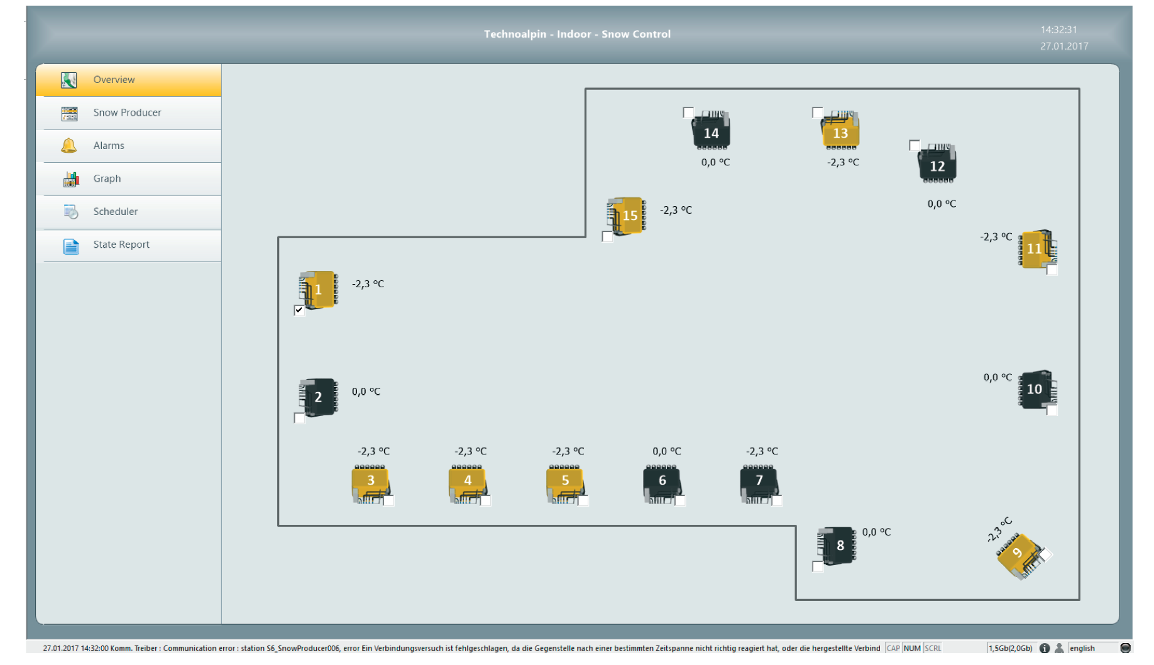
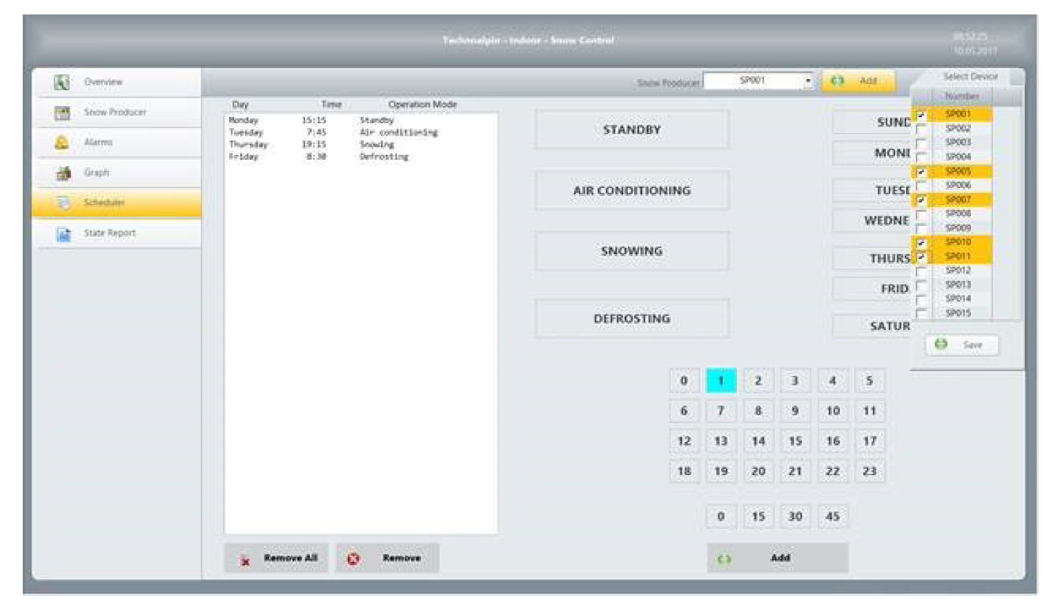
AUTOMIZED SNOW CONTROL SOFTWARE
Intelligent 3D snow making: depending on the installation height the snow maker regulates automatically the water flow and increases automatically its productivity and efficiency
The SNOW CONTROL is the visualisation tool of the software where all parameters of the snow making systems can be tracked
A time scheduler program enables the operator to define specific time slots for snow production for different snow machines / or groups of snow machines
Parameters for different snow qualities are set and can be activated by a click – do depending on the needed snow resources are ideally used

