Slide 1

Technology Driven Solutions
www.dattatreyainc.com
Vadodara, Gujarat, India

Slide 2

ABOUT US
 Representꢀ10ꢀglobalꢀcompaniesꢀfromꢀ7ꢀcountries.
 Serveꢀclientsꢀinꢀaꢀwideꢀrangeꢀofꢀapplications
 Knownꢀforꢀlaunchingꢀwellꢀprovenꢀinnovativeꢀ
technologies,ꢀwhichꢀareꢀacceptedꢀworldꢀover.
 Ourꢀgoalꢀisꢀtoꢀsuccessfullyꢀimplementꢀworld-classꢀ
valueꢀdrivenꢀtechnologyꢀofꢀtheꢀhighestꢀstandardꢀ
forꢀshapingꢀtheꢀfuture;ꢀbackedꢀbyꢀaꢀteamꢀofꢀ
creativeꢀ&ꢀdynamicꢀpeople.ꢀ

Slide 3
COMPANIES REPRESENTED
 ReliningꢀandꢀRehabilitationꢀofꢀPipelinesꢀofꢀanyꢀsizeꢀ&ꢀshapeꢀ
(Water/Sewerage/Gas/Oil)
ØNordiTube, Belgium / RTi, Austria
ØAPM, USA
ØConShield, USA
ØPipemedic / Qwrap, USA
 Manholeꢀ&ꢀSTPꢀ/ꢀWellꢀReliningꢀandꢀRehabilitationꢀ–ꢀ
 APM, USA
 NonꢀExplosiveꢀEco-friendlyꢀRockꢀFragmentationꢀ–ꢀ
 KAPRA, South Korea

Slide 4
COMPANIES REPRESENTED
 ArtificialꢀIndoorꢀ&ꢀOutdoorꢀSnowꢀMakingꢀSystem
ØSnowꢀChambersꢀ–ꢀSnowꢀMakingꢀSystemꢀIndoorꢀ/ꢀ
OutdoorꢀApplicationsꢀ–ꢀTechnoAlpin, Italy
 TrenchlessꢀUtilityꢀServices
ØLayingꢀofꢀUndergroundꢀPipesꢀbyꢀMicroꢀTunnelling-ꢀ
MTS / Perforator, Germany
Ø NonꢀExplosiveꢀ/ꢀLowꢀExplosiveꢀRock/RCCꢀSplittingꢀforꢀ
trench,ꢀunderwaterꢀ&ꢀgeneralꢀexcavation:
Ø Betonamit, Europe
ØNxco Mining Technologies, South Africa

Slide 5
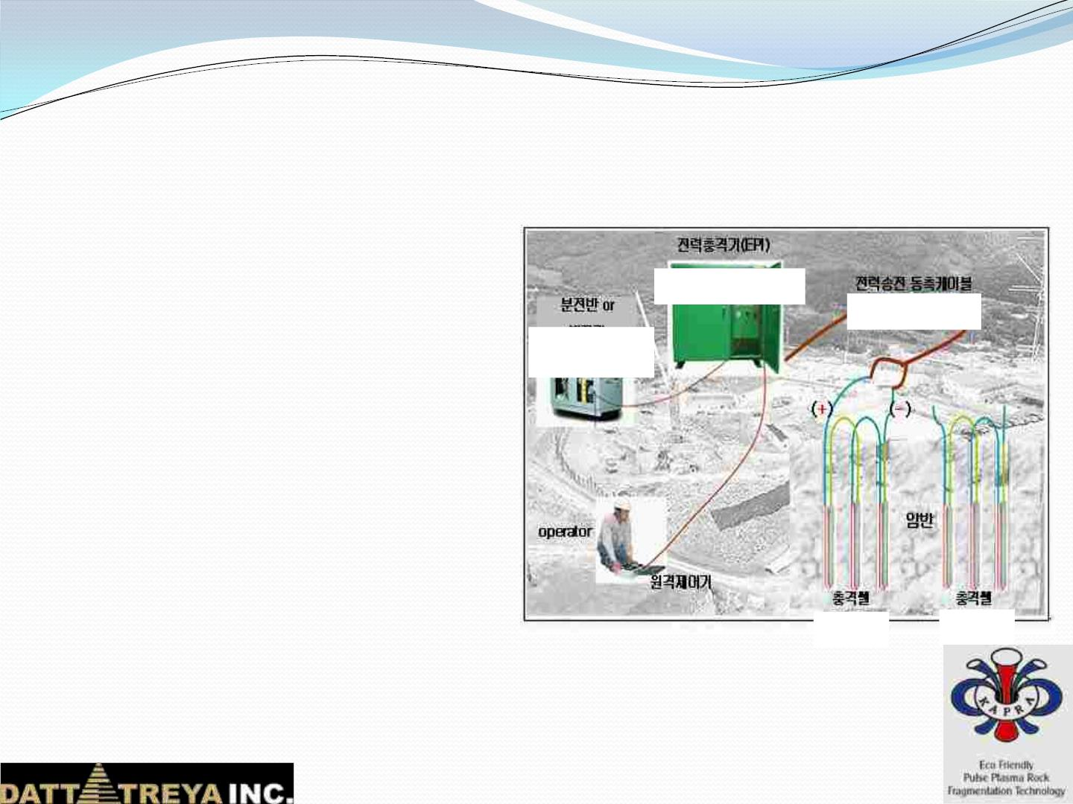
KAPRA, SOUTH KOREA
 EcoꢀFriendlyꢀPulseꢀPlasmaꢀRockꢀ
FragmentationꢀTechnology
 Aluminumꢀ&ꢀCopperꢀOxideꢀ
powderꢀenergizedꢀinꢀ
GENERATOR
EPI PULSE
millisecondsꢀtoꢀaꢀPlasmaꢀstageꢀ
usingꢀElectrostaticꢀPowerꢀ
Impulseꢀ(EPI)ꢀGenerator.
PULSE
GENERATOR
 Processꢀgeneratesꢀtheꢀheatꢀ&ꢀ
impactꢀwaveꢀtoꢀcrackꢀ&ꢀbreakꢀ
theꢀrock.
 ImpactꢀCells:
Ø 2Alꢀ+ꢀ3Cuoꢀ=ꢀAl2O3ꢀ+ꢀ3Cuꢀ+ꢀ
CELL
CELL
1197ꢀKJ

Slide 6
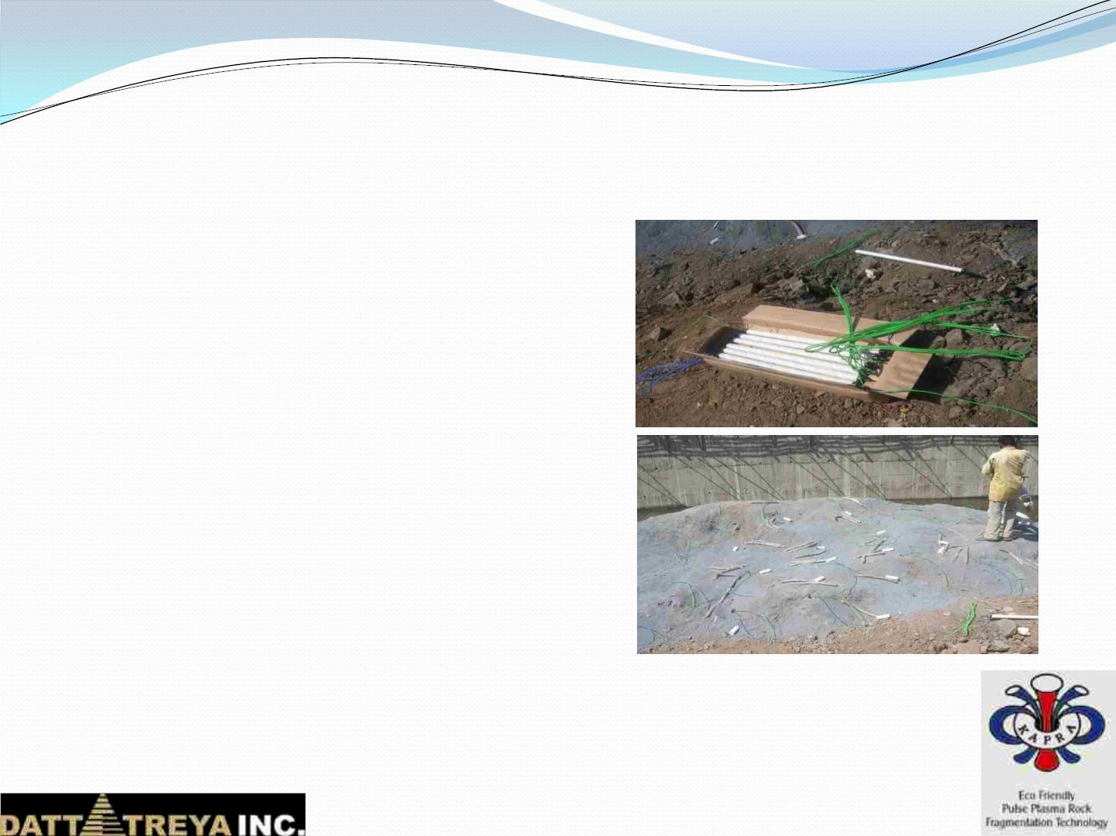
KAPRA, SOUTH KOREA
 Advantages
Ø Non-ꢀExplosive
Ø NoꢀLicenseꢀrequired
Ø LowꢀVibrationꢀandꢀnoise
Ø Noꢀflyingꢀrocksꢀandꢀgases
Ø Noꢀresonanceꢀgenerated
 Applications
Ø BuildingꢀFoundations
Ø Tunnels
Ø NextꢀtoꢀAirport,ꢀRailꢀLines,ꢀRoads,ꢀ
Dams,ꢀCanals,ꢀPipelines,ꢀUtilityꢀ
Networks
Ø Forꢀweakꢀandꢀhardꢀrockꢀboth

Slide 7
NordiTube, Austria & RTi, Australia
 NordiTube Technologies,established since 1987.
 CIPP liner products are available for rehabilitation of Gravity feed
Sewer Pipes, Rising main; Pressurized Potable water pipeline,
industrial water.
 Technologies Proposed:
 CIPP – Steam curing / Hot water curing.
 Close fit (Pre deformed PE Pipes)
 Spiral wound system
 Rehabilitation of tanks & manholes.
 Liners are available for DN50-1400.
 Liners are supplied in single length up to 1000 & installed up to length
of 200 meters depending upon diameter & thickness of liner
 NSF 61 Approved for Potable Water application.
 Liners available to suit High Temperature.

Slide 8
NordiTube, Austria & RTi, Australia
 NordiTubeTUBETEX G HYTREL liner consists of a woven textile.
 Suitable for Rehabilitation of Gas Pipeline from DN 150 - 1000 mm
 Liners are suitable up to30 Bar pressure& single length installation
up to 600 meter & computable withbends.
 On one side anHYTREL coating, which is the new inner pipe surface.
 Using a special epoxy resin system to bond entirely to host pipe.
TUBETEX G HYTREL classified as “Class C” according toISO 11295.
 Seamless liner with even wall thickness (coating thickness of 1 mm
& liner thickness of 3.1 mm) over the circumference.
 Certified by DVGW GW 327; DVGW 270; W330; VP 404; DIN 30658-1;
KTW-BWGL; ACS
 Liners installed using well proven inversion processwith Steam
curing.

Slide 9
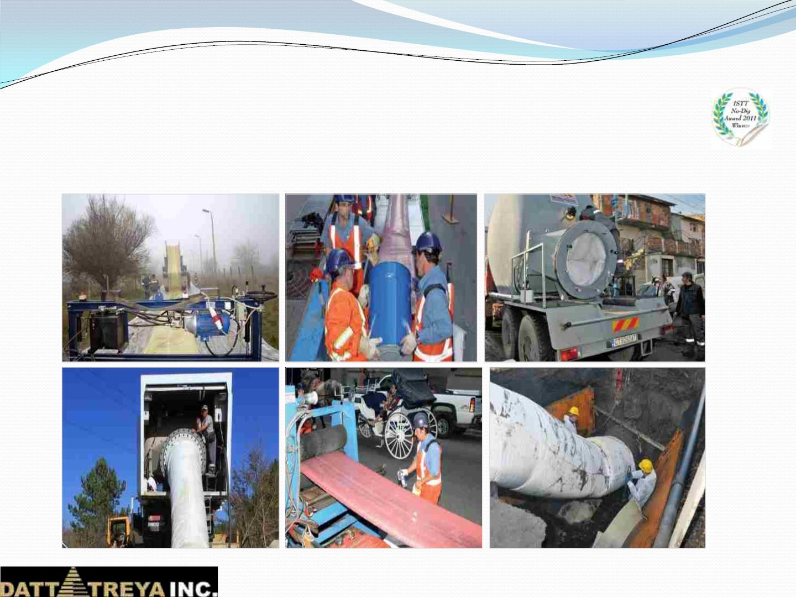
NORDIFLOW – Case Studies
Shumen, Bulgaria Montreal, Canada
Sofia, Bulgaria
Diameter:
Length:
920 mm (36 in)
328 m (1076 ft.)
Diameter:
Length:
730 mm
4600 m
(29 in)
(15092 ft.)
Diameter:
Length:
1220 mm (48 in)
850 m (2788 ft.)

Slide 10
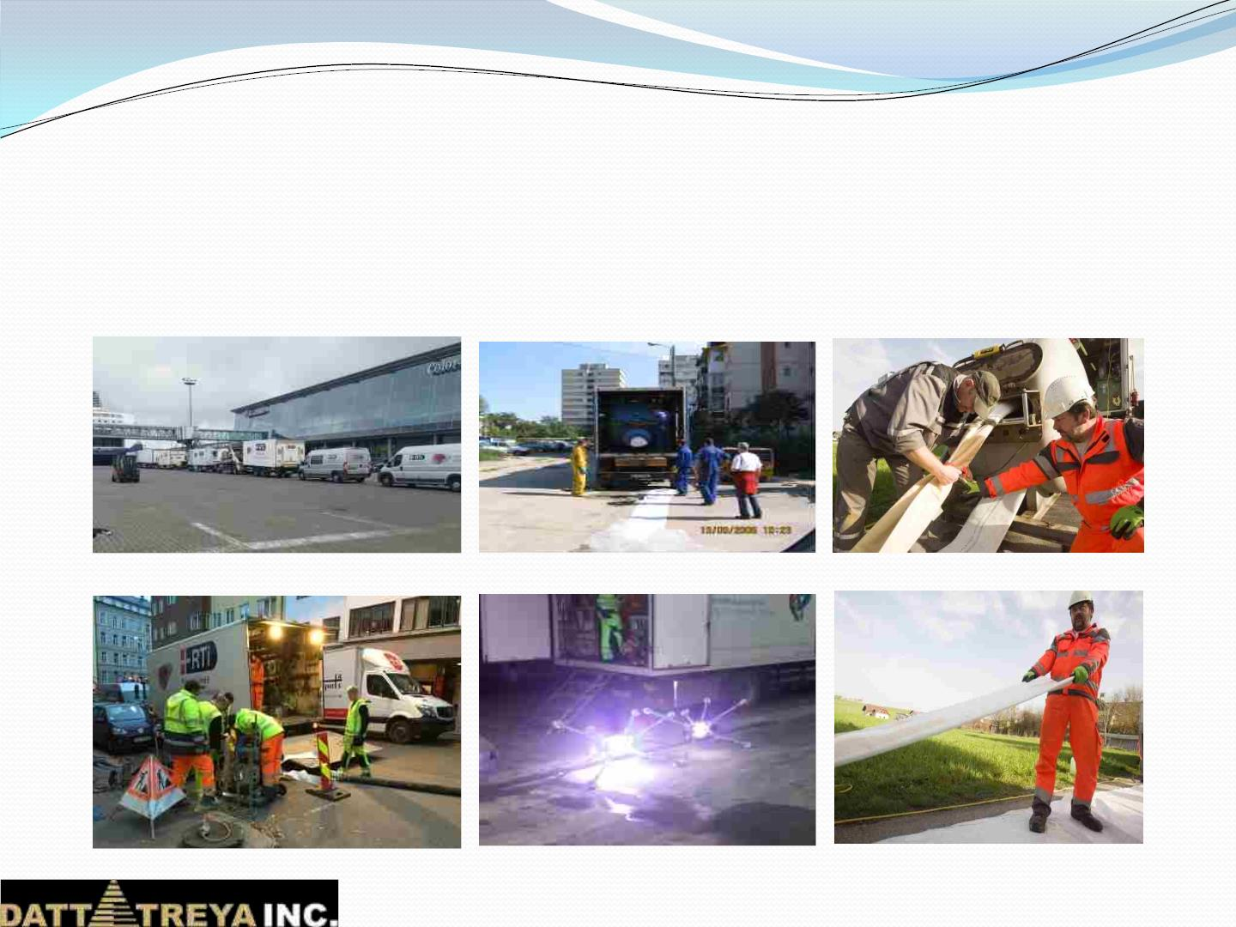
SEWER NETWORK PROJECTS-Case Studies
Norway
2005
Craiova, Rumania
Vahostav, Slovakia
Since:
Since:
Diameter: 200 - 380 mm
Length:
2006
Diameter: 250 - 1200 mm
Since:
2009
Diameter: 300 - 1000 mm
10 km
CIPP
Length: 42 km
CIPP, GRP, Shortpipe
Length:
9 km
CIPP

Slide 11
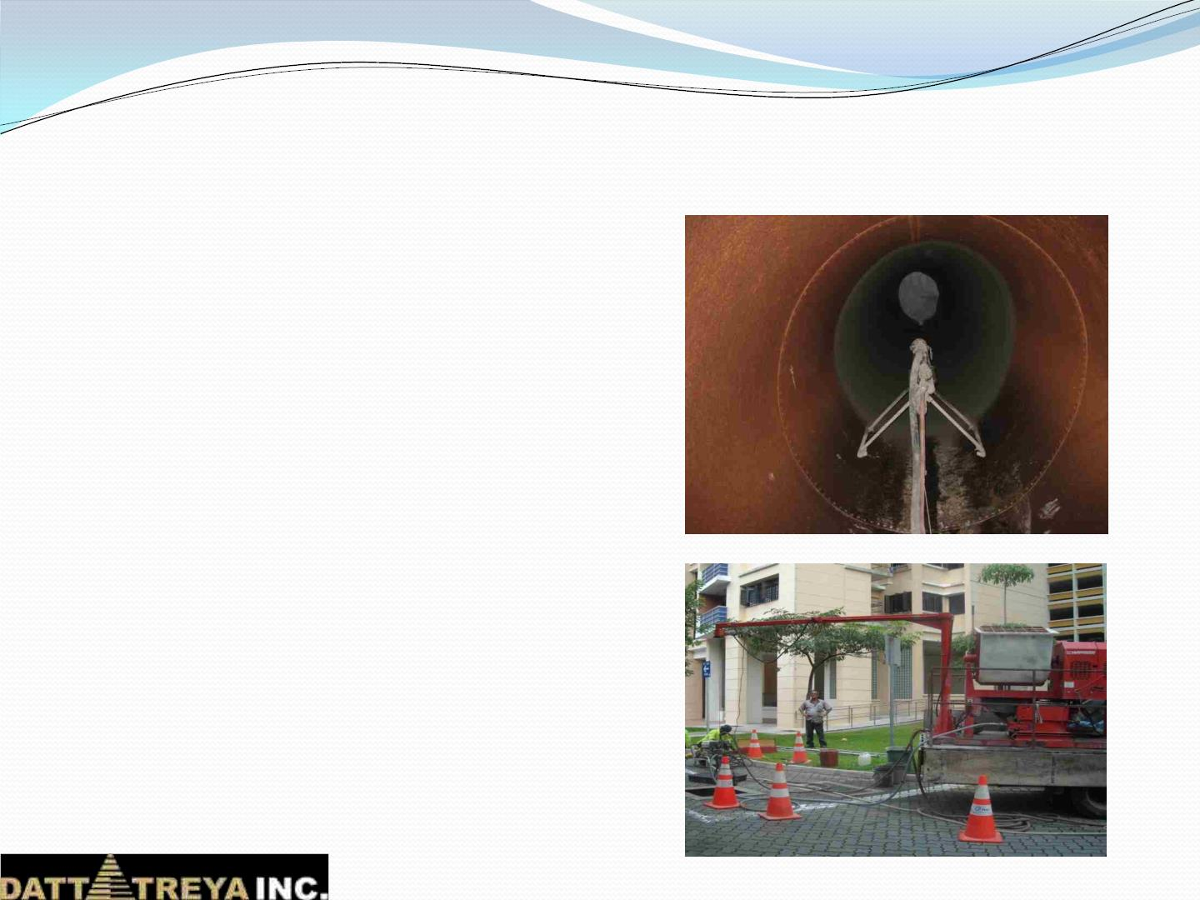
APM, USA for pipes
 StructuralꢀRenewalꢀ&ꢀRehabilitationꢀ
ofꢀpipes,ꢀsewersꢀ&ꢀculverts
 Techniques
Ø CentriPipeꢀ:ꢀstructurallyꢀsoundꢀ
seamlessꢀconcreteꢀpipeꢀinsideꢀtheꢀ
oldꢀstormꢀ&ꢀsanitaryꢀsewerꢀpipe
Ø Conshieldꢀ:ꢀ100ꢀ%ꢀProtectionꢀ
fromꢀMIC
Ø Permacastꢀ:ꢀIncreaseꢀStructuralꢀ
Strength
Ø COR + GARD - Chemicalꢀ
Protectionꢀ&ꢀHighꢀtemperatureꢀinꢀ
sewerꢀlines
Ø COR + ROC - Chemicalꢀ
Protectionꢀforꢀspotꢀrepairs

Slide 12
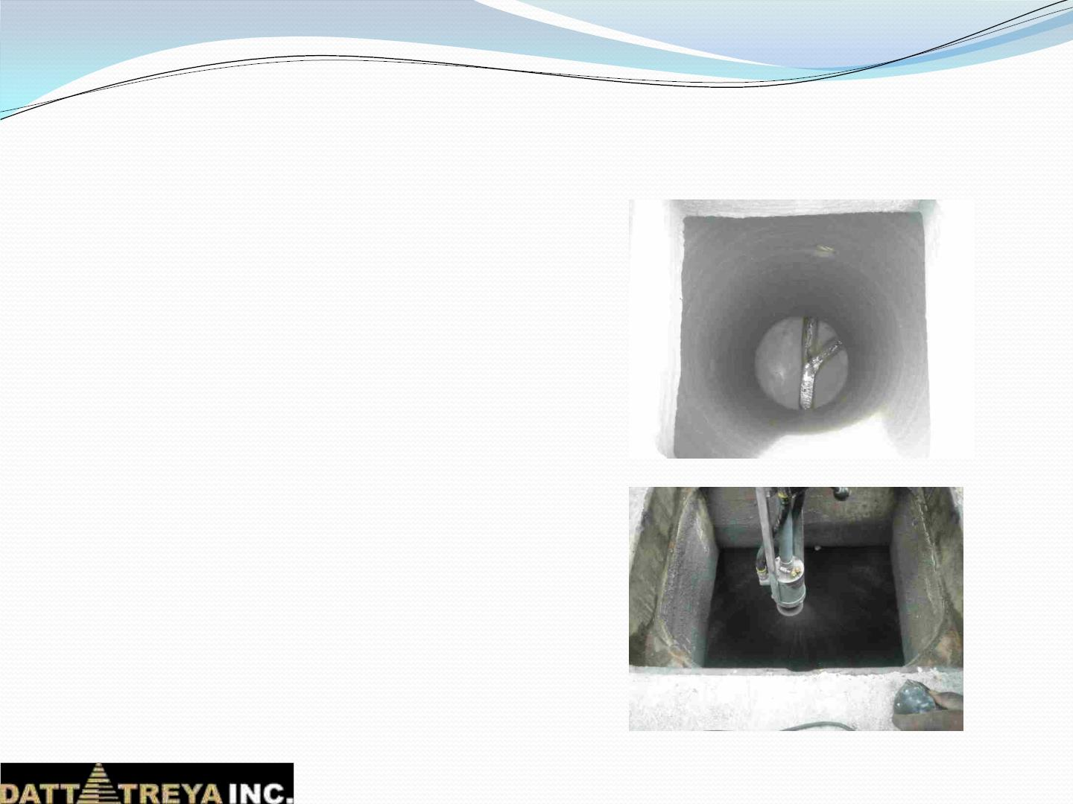
APM, USA for Manholes
 StructuralꢀRenewalꢀandꢀ
RehabilitationꢀofꢀManhole
 Cylindrical,ꢀSquare,ꢀTrapezoidꢀetcꢀ–ꢀ
anyꢀshapeꢀofꢀmanholesꢀrelined
 ½ꢀinchꢀtoꢀ1ꢀinchꢀthicknessꢀofꢀ
premixedꢀcementitiousꢀmixtureꢀ
applied
 Techniques
Ø Permacastꢀ:ꢀRehabilitationꢀofꢀ
Manholes

Slide 13
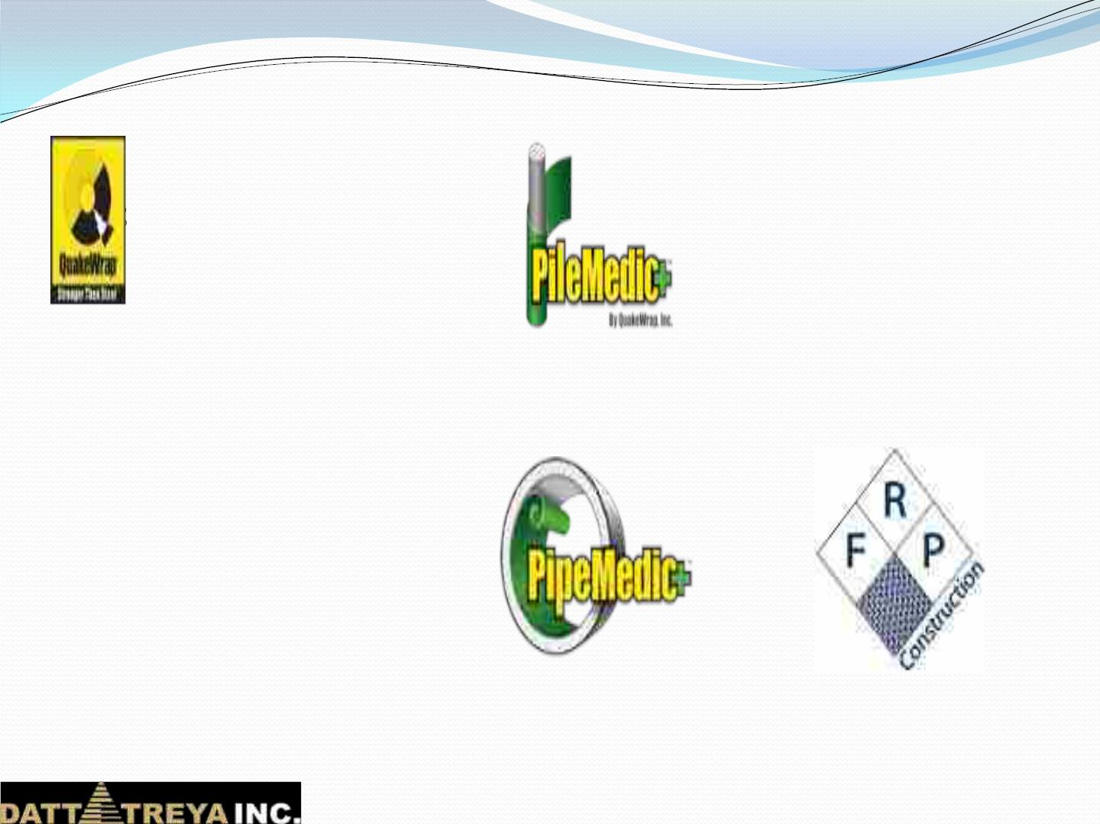
QuakeWrap ….
Ø
Ø
QuakeWrap is a specialty Engineering/ Construction Company
eveloped many patented technologies
ffices in Tucson, AZ & Hermosillo, MX
lients contact us with problems – worldwide
We provide turnkey solutions including:
Ø
Ø
Ø
Engineering
Materials
Installation by our Construction Team
Ø
We take full responsibility for the repair
This model has resulted in numerous Awards of Excellence
QuakeWrap Inc.
PileMedic, LLC
PipeMedic, LLC
FRP Construction, LLC

Slide 14
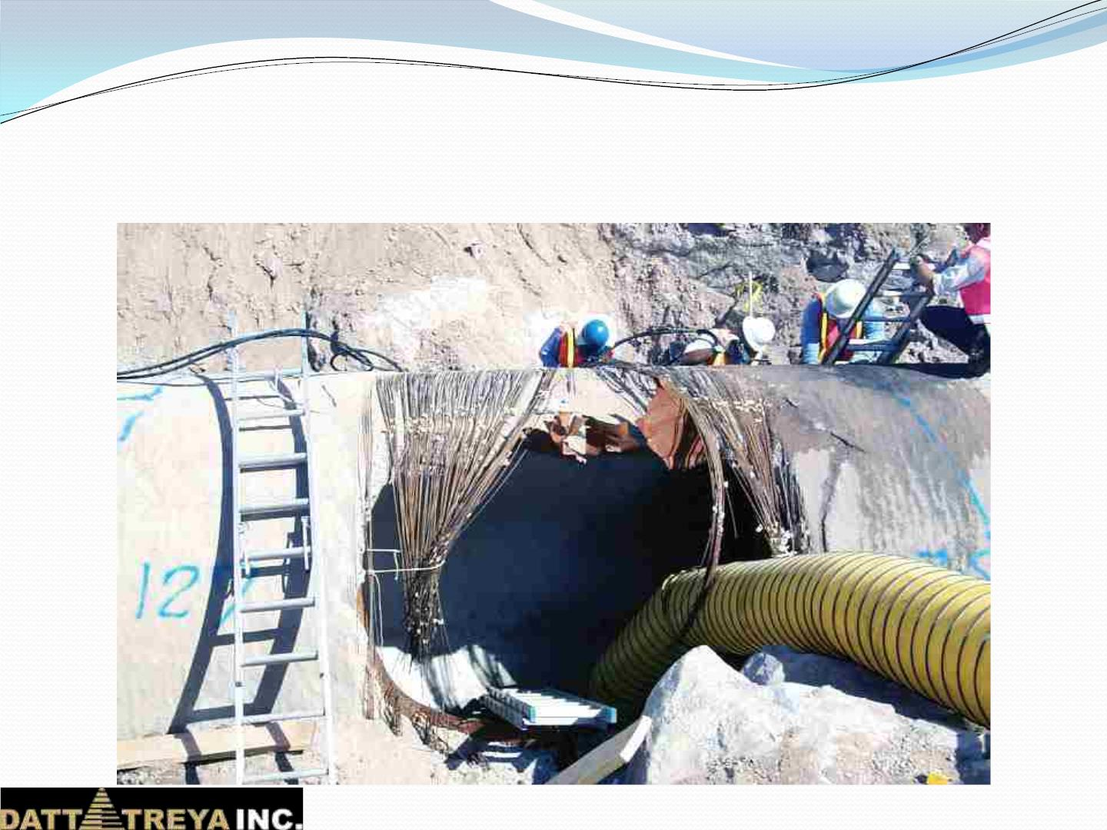
Tucson Water 1999 Failure of 96-
inch (2.4 m) PCCP

Slide 15
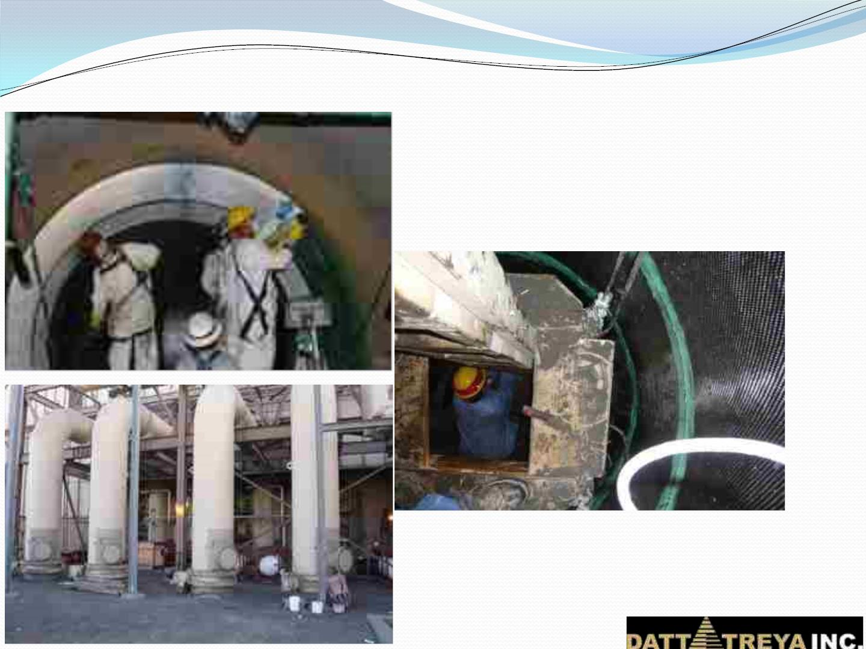
Power Service of New Mexico (PNM)
120-inch diameter PCCP (Oct 2007)
Protective glass layer on steel
pipe
Tight work space in
48” steel risers

Slide 16
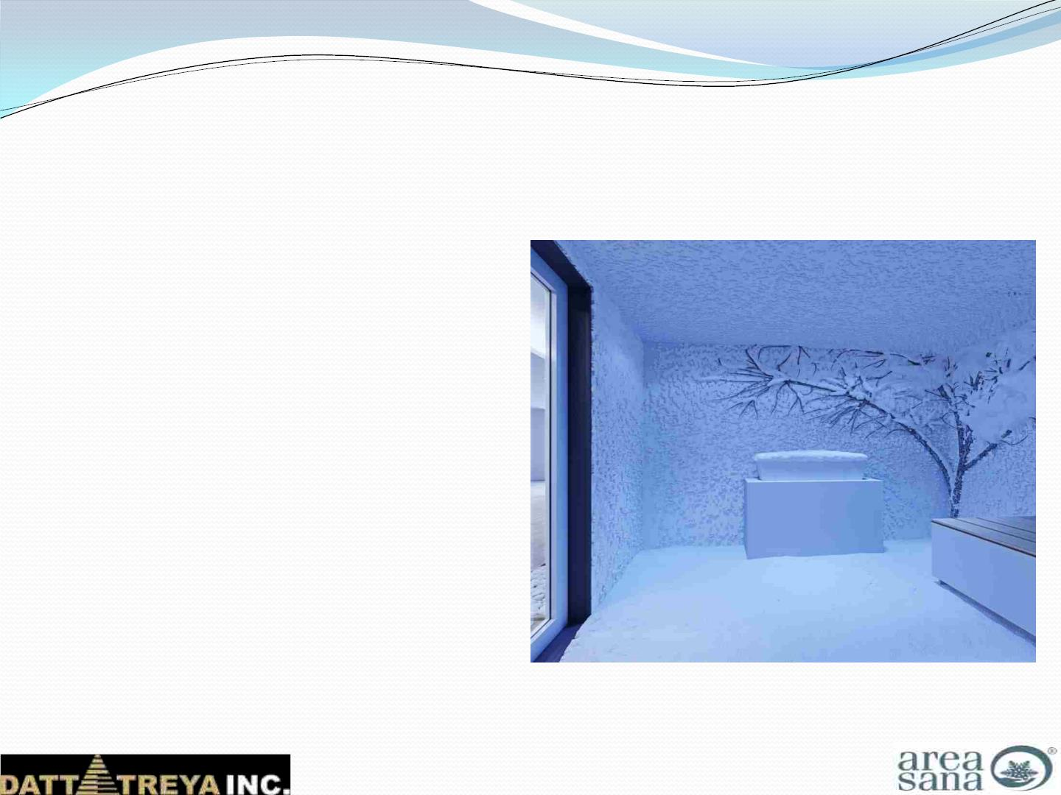
AREASANA by TechnoAlpin, ITALY
 Artificial Snow Rooms built as
per client design
 Snow Treatment scientifically
proven to be more beneficial than
dip in cold water after sauna
 Benefits
Ø Increases blood circulation
Ø Strengthens immunity
Ø Improved skin tone
Ø Relaxation Therapy
Ø Strengthens Pain Reception

Slide 17
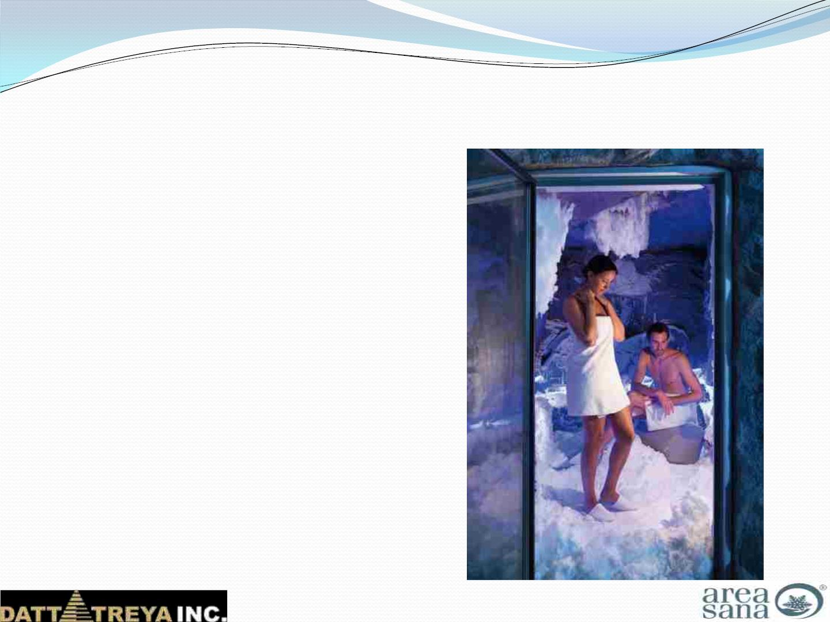
AREASANA by TechnoAlpin, ITALY
 Available from 6 sq m size to 15 sq m.
 Technical room required
 30 l/hr water consumption
 11-18 kW Energy Requirement
 Applications
Ø Resorts
Ø 5 Star Hotels
Ø Villas
Ø Commercial Buildings
Ø Gymnasiums
Ø Spas

Slide 18
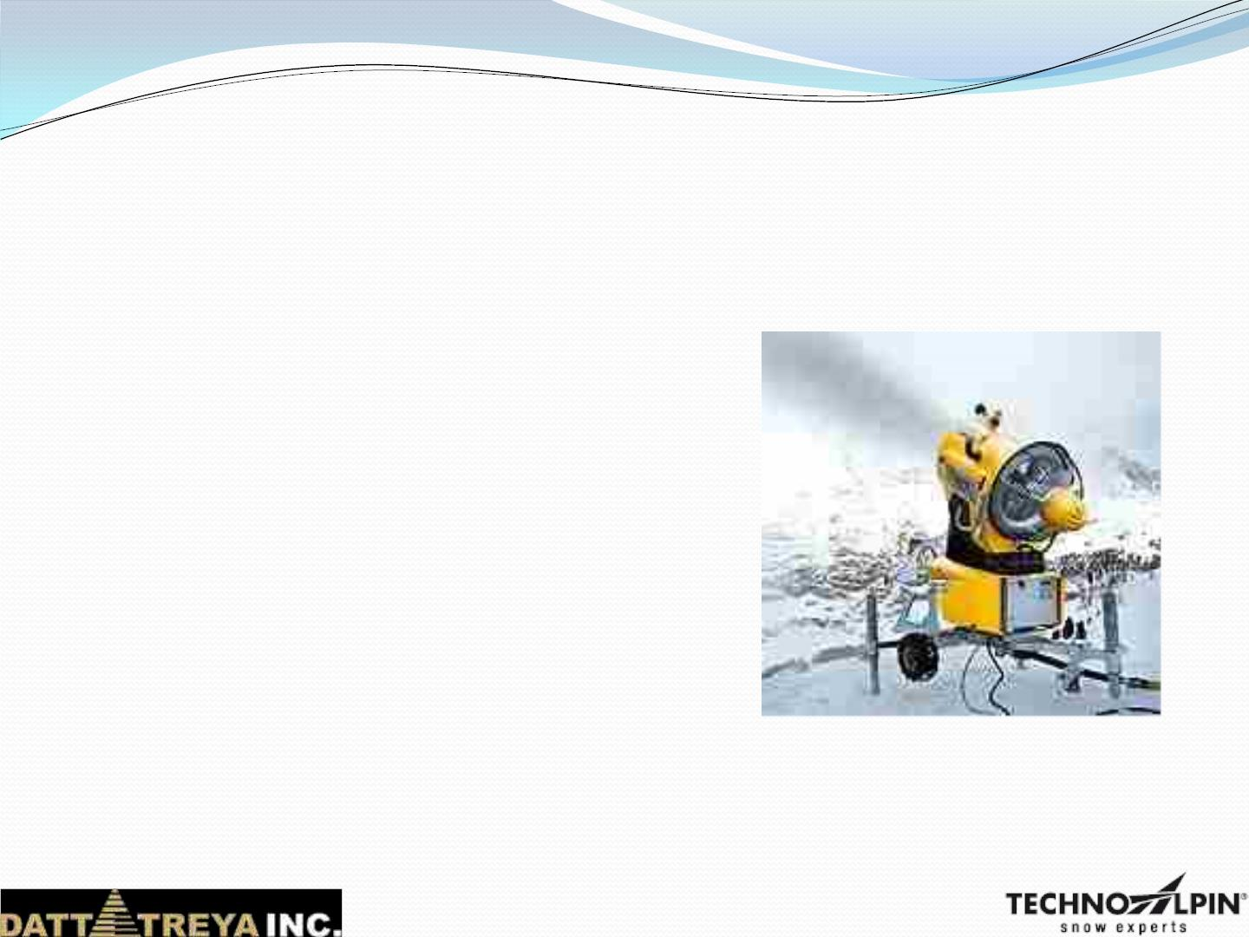
TECHNOALPIN, ITALY
 DesignsꢀandꢀProvidesꢀcustom-builtꢀ
snowꢀmakingꢀsystemsꢀforꢀindoor&ꢀ
outdoorꢀsnowꢀparksꢀandꢀskiꢀresortsꢀ
ꢀsinceꢀ25ꢀyears.
 WorldꢀLeadersꢀinꢀSnowꢀMakingꢀ
Systemꢀ(ꢀ60ꢀ%ꢀofꢀtheꢀworldꢀmarket)
 SnowꢀGunsꢀandꢀSnowꢀLancesꢀ
availableꢀforꢀbuildingꢀartificialꢀskiꢀ
slopes

Slide 19
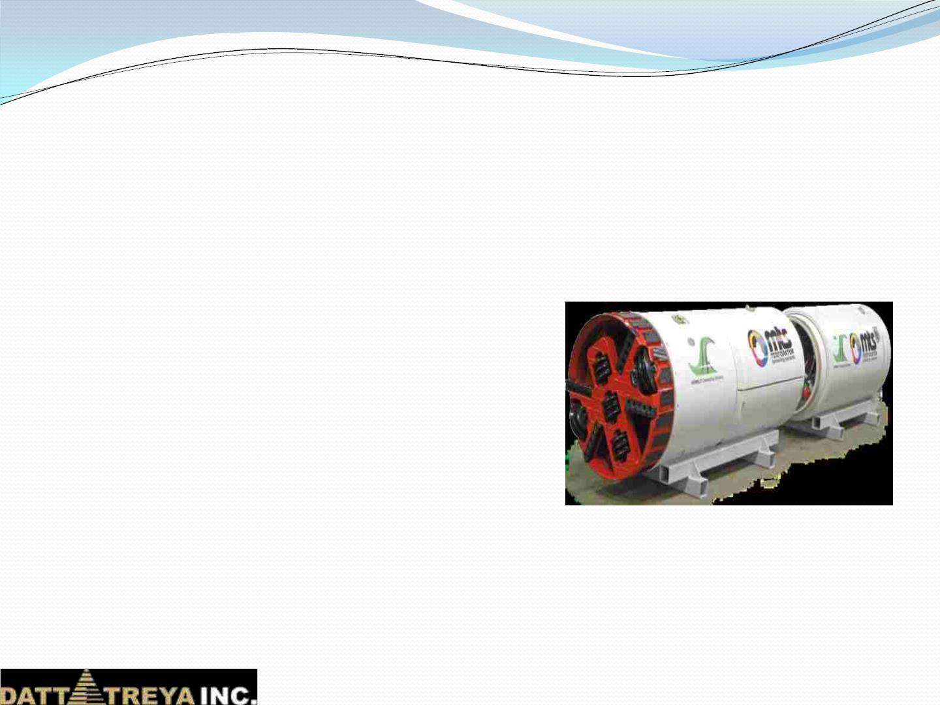
MTS / Perforator, GERMANY
 Manufactures tunnelling systems &
Guided Thrust boring machines.
 Diameter 200mm to 3600mm and more
 Suitable to work in any type of subsoil
conditions
 Multiple power jack for jack rigging and
cutter head
 Mechanical & Hydraulic Soil Removal
 Intermediate jacking stations & slurry
pumps for underwater condition
 Thrust Boring and Pipe Bursting
Machine

Slide 20
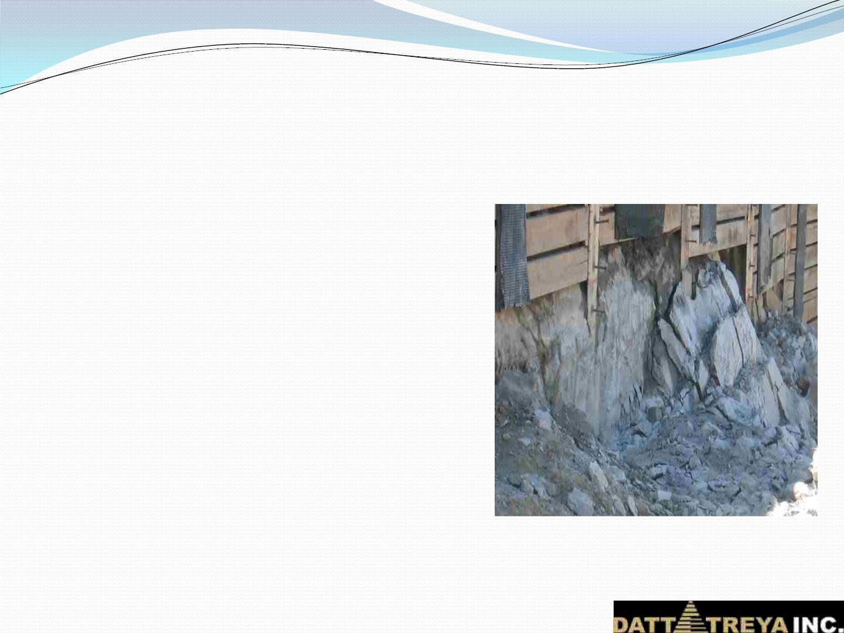
Betonamit, Europe
 EcoꢀFriendlyꢀNonꢀExplosiveꢀ“Betonamit”ꢀ
RockꢀSplittingꢀMortarꢀfromꢀEurope
 Materialꢀisꢀmixedꢀwithꢀcoldꢀwaterꢀ&ꢀ
pouredꢀinꢀtheꢀdrilledꢀholes.
 Expansionꢀpressureꢀallowsꢀcrackꢀ/ꢀcutꢀ
towardsꢀfreeꢀface.
 Applications
Ø Softꢀandꢀhardꢀrock
Ø Sensitiveꢀareasꢀnearꢀtoꢀairports,ꢀrails,ꢀ
buildingsꢀetc
 Benefits
Ø Noꢀvibrations,ꢀnoiseꢀandꢀdust
Ø Noꢀflyingꢀrocks
Ø Noꢀhindranceꢀtoꢀnearbyꢀworks

Slide 21
Nonex from Nxco, South Africa
 Low explosive technology – category 1.4S
 Used for Trench, Tunnel, RCC fracturing, Shaft,
Under Water application, Demolition, Open Cast
mining etc.
 Sequential blasting available for specified application.
 Low dust / flying of Rock / Sound.
 No Shock wave & suitable for seismic sensitive areas.
 Different sizes of cartridge to meet individual
application.
 Required license for import / usage / storage &
transport
 Easily air lifted in commercial Cargo.

Slide 22
THANK YOU
Forꢀfurtherꢀdetailsꢀcontact:
Dattatreya INC.
(M):ꢀ+91ꢀ98240ꢀ49872
sumul.patel@dattatreyainc.com
www.dattatreyainc.com

