Slide 1
Pulse Plasma Rock Fragmentation
Delivering a unique eco-friendly non-explosive rock fragmentation solution
x

Slide 2
Content
Sr No. | Description
1 | Existing Rock Excavation Methods
2 | Pulse Plasma Features & Benefits
3 | Pulse Plasma Application & Projects
4 | Patents and Contact Information

Slide 3
Existing Rock Excavation Methods
Method | Advantages | Constraints
Conventional Blasting | Cheapest Method Suitable for High Volumes | Permission & license required for usage, storage & transportation Not permitted near critical & sensitive areas: Docks, dams, existing infra, railway lines, oil and gas pipeline etc.
Control Blasting | Cheap Good Volumes | Permission and license required for usage, storage and transportation
Mechanical Excavation | Relatively Expensive Easy to use Services available in local areas | Volume excavation not possible for hard rock High time consumption High noise
Rock Splitter | Good for confined spaces like trenches, vertical shaft, tunnel corners | Relatively expensive Volume excavation not possible
Chemical Process | High effectiveness when all surfaces are free Easy to use | Volume excavation not possible / time consuming Not effective on hard rock & compressed rock Drilling cost is higher
Wire Cutting | Although suitable for Granite & Marble but can work in precise areas | Expensive Cannot be used in corners of plot / bottom / slopes etc Low output

Slide 4
Content
Sr No. | Description
1 | Existing Rock Excavation Methods
2 | Pulse Plasma Features & Benefits
3 | Pulse Plasma Application & Projects
4 | Patents and Contact Information

Slide 5
Pulse Plasma Process Components
Process Components

Slide 6
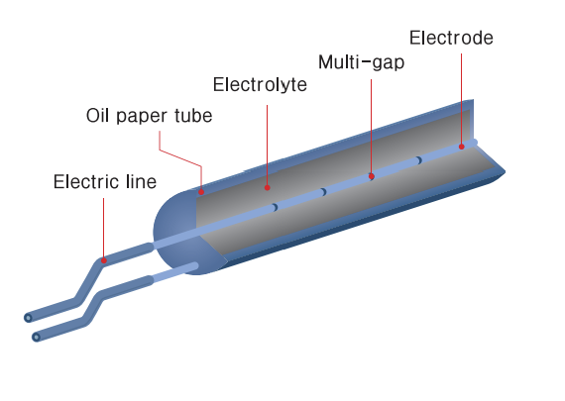
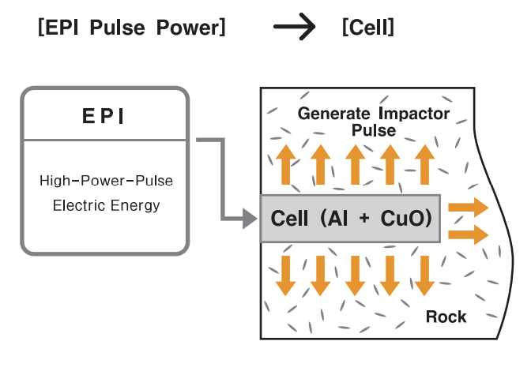
Plasma Cell Features
Electrolyte mix of Aluminum and Copper Oxide inside an oil paper tube (Length = 800 mm ; Weight = 1.234 kg)
When supplied with a high-power pulse of 134 MW electric energy for a millisecond, electrolyte mix converts into plasma stage, generating high heat and impact wave causing rock fragmentation with low noise & vibration levels within IS.
Eco-friendly and non-explosive (PESO Certified)
Can be transported by sea / air / road
No specific secured zone required for storage.
Reaction of the cell when supplied with electric pulse
2Al + 3CuO = Al₂O₃ + 3Cu + 1197 kJ

Slide 7
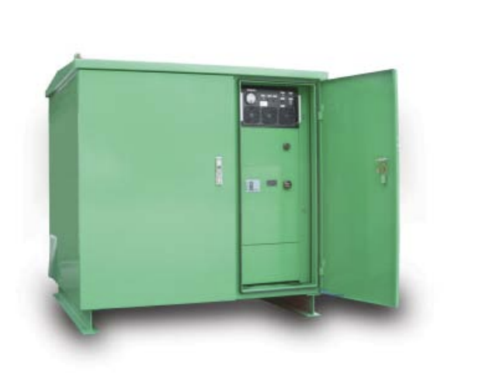
Electro Power Impactor (EPI) Features
Input Power | 20 kW (380 V AC, 3 ø)
Capacitor | 9000 V DC , 830 µF 8 ea parallel circuit
Max. Energy Storage | 268.92 kJ
Max. Output Energy | 134460 kJ
Weight | 1.2 tons
EPI Plasma Blasting Process
Power Input 380 V or Generator
Discharge High Voltage High Current
Cell Reaction Convert to plasma stage
Thermite Reaction Impact Energy
EPI Energy Stored
Rock Breaking

Slide 8
Pulse Plasma Benefits
No Blasting Permission Required to use this highly efficient non-explosive technology
Efficiency & Speed
Efficiency of 2.7-3 cubic m per cell*
Can blast 5-7 holes in each pulse plasma cycle
Significantly reduces project execution timelines
Secondary breaking not required or easier due to high fracture rate
Reaction at 3000 ºC vs-controlled blasting reaction at 1300 ºC
Low Vibrations & Sound
Other Benefits
Eco-friendly
No gas generation as the process is thermite
Low Dust and flying of rock
No resonance generated due to no overlapping frequency thereby not affecting nearby infra
Distance | EPI | Control Blasting
20 m | .092 kine | 1.8 kine
30 m | .089 kine | 1.15 kine
Distance | EPI | Control Blasting
20 m | 67.6 dB | 83.2 dB
30 m | 65.3 dB | 78.9 dB
*For confined area like Tunnels / trench application / Shaft etc., output per cell might come down and vary from 1.6 to 2.2 cum per cell depending on the available free face, type of rock, formation of rock, drilling pattern etc.

Slide 9
Content
Sr No. | Description
1 | Existing Rock Excavation Methods
2 | Pulse Plasma Features & Benefits
3 | Pulse Plasma Application & Projects
4 | Patents and Contact Information

Slide 10
Pulse Plasma Application
Drill Holes
Insert Plasma Cell
Use sand / Smart Stem to plug hole
Charge EPI using generator
Provide Pulse to Cells
Remove fragmented rock
Key Highlights
Drill Hole details
Hole Diameter : 51 mm
Hole Depth : 2.4 to 3 m
1 hole will consume 1 plasma cell
Multiple cells are connected in every pulse plasma cycle depending on rock strata and project requirements
1 cycle from the stage of inserting cells to rock breaking will take about 3 - 5 mins
Usage of rubber mats above the holes during the fragmentation is mandatory for safety purposes
Presence of Korean Expatriates along with Dattatreya Inc. Project Managers mandatory for project execution
Only Korean Expatriates are permitted to use the plasma cells along with EPI

Slide 11
Major Projects in India
Sr No | Client Name | Contractor Name | Location | Project Details
1 | MCGM | RPS Infraprojects Pvt Ltd | Mumbai | Mithi River Deepening
2 | MCGM | Relcon Infrastructure Pvt Ltd | Mumbai | Mithi River Deepening
3 | Hiranandani Group | Jyoti Infrastructure Pvt Ltd | Mumbai | Building Foundation
4 | Oberoi Realty | Vishwajeet Sood | Mumbai | Building Foundation
5 | Bengaluru International Airport Authority | L&T | Bengaluru | Airport terminal building Foundation
6 | Delhi Metro Rail Corporation | L&T | Delhi | Excavation for developing Underground Metro Station
7 | Panchshil Realty | Satish Earthmovers | Pune | Building Foundation
8 | Konkan Railways | SRC Infrastructure Pvt Ltd | Pen | Rock Excavation for Track Widening
9 | Orissa Water Supply & Sewage Board | BAIL | Sambalpur | Orissa Water Supply Scheme

Slide 12
Project Videos
https://youtu.be/RUMcLvFJy3Q - Pulse Plasma Rock Fragmentation (PPRF) explanation
https://youtu.be/BKfYQA0HtWc – PPRF under existing infra / tunnel
https://youtu.be/NJe8bmjmpzk - PPRF adjoining existing wall / building
https://youtu.be/RsytGgPlpRw - PPRF adjoining existing wall

Slide 13
Content
Sr No. | Description
1 | Existing Rock Excavation Methods
2 | Pulse Plasma Features & Benefits
3 | Pulse Plasma Application & Projects
4 | Patents and Contact Information

Slide 14
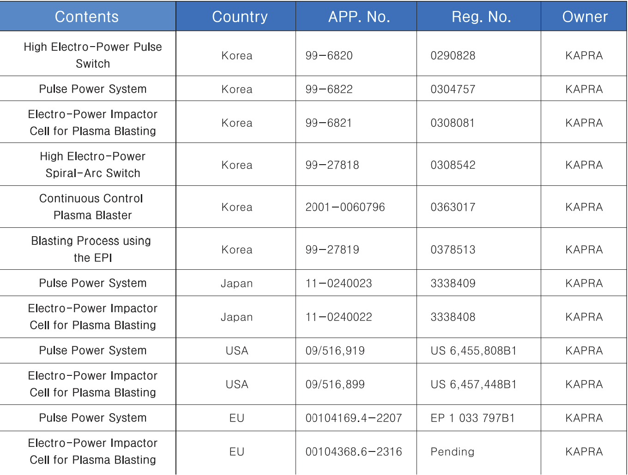
Certifications & Patents

Slide 15
Contact Information Sumul Patel sumul.patel@dattatreyainc.com www.dattatreyainc.com M: +919824049872 Yash Patel yashpatel.2910@outlook.com M: +916353927986
x

