Slide 1
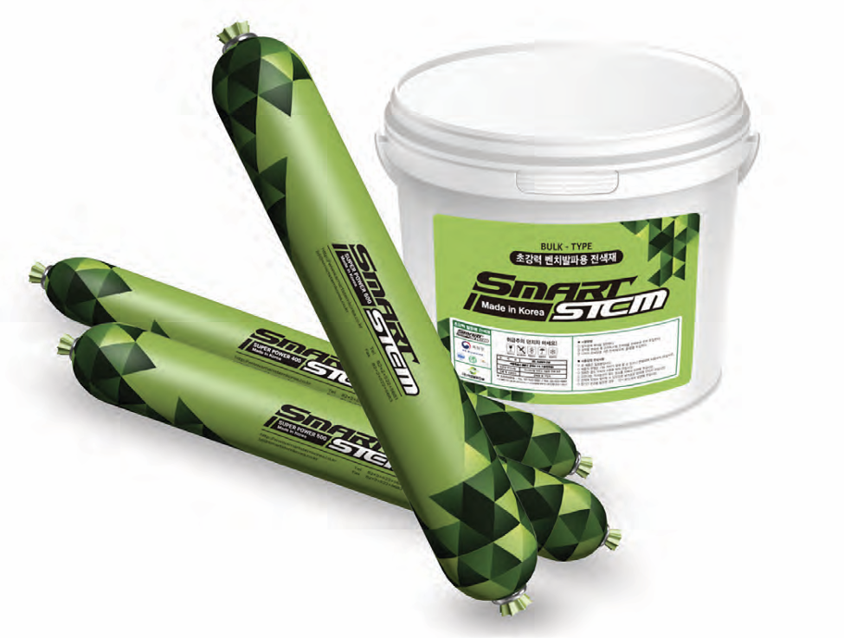



SMART STEM
Revolutionizing Bench & Tunnel Blasting through Innovative Stemming
x

Slide 2
Content
Sr. No. | Description
1. | Traditional Stemming Method
2. | Smart Stem Features & Benefits
3. | Smart Stem Application
4. | Certifications & Contact Information

Slide 3
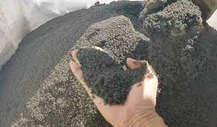

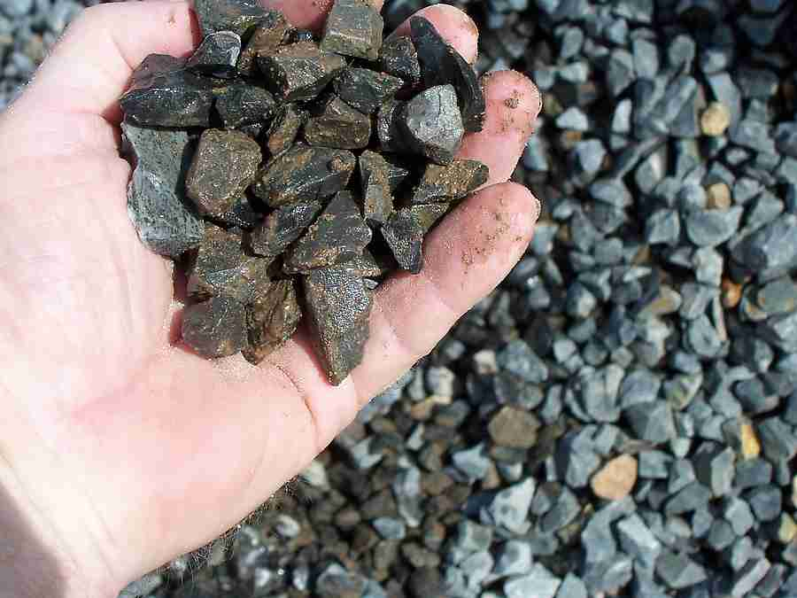
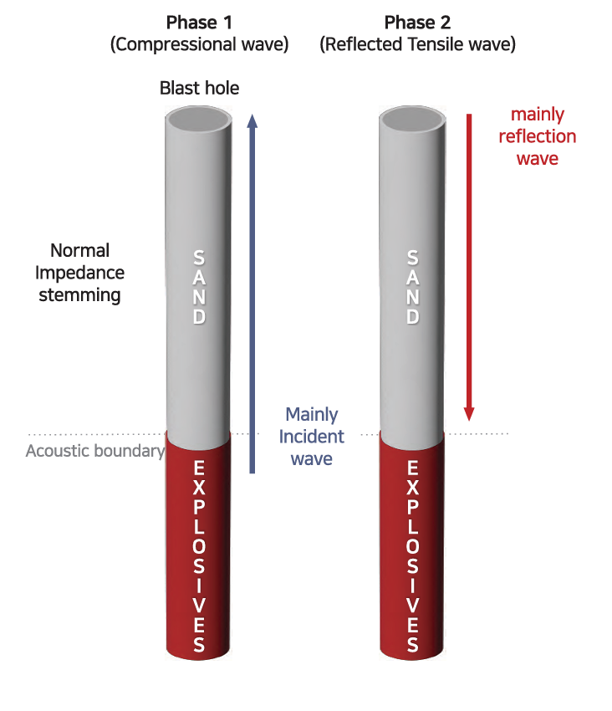
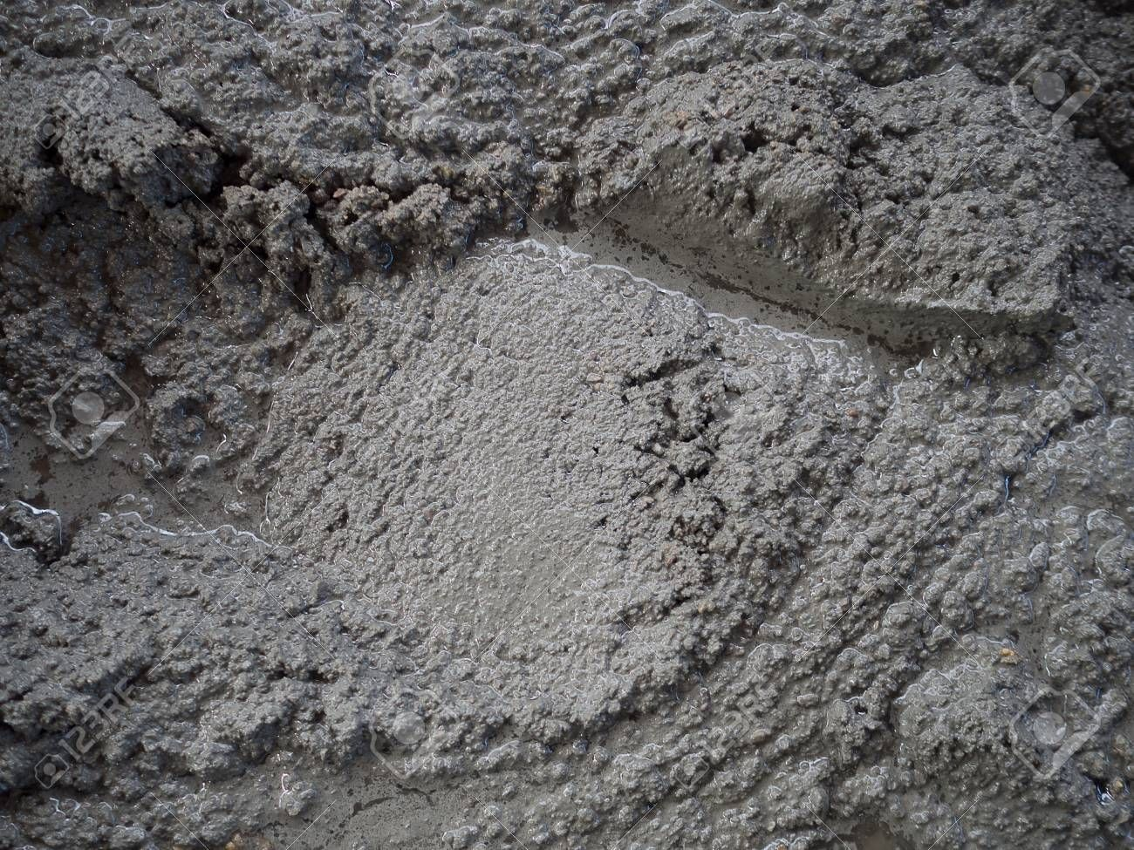
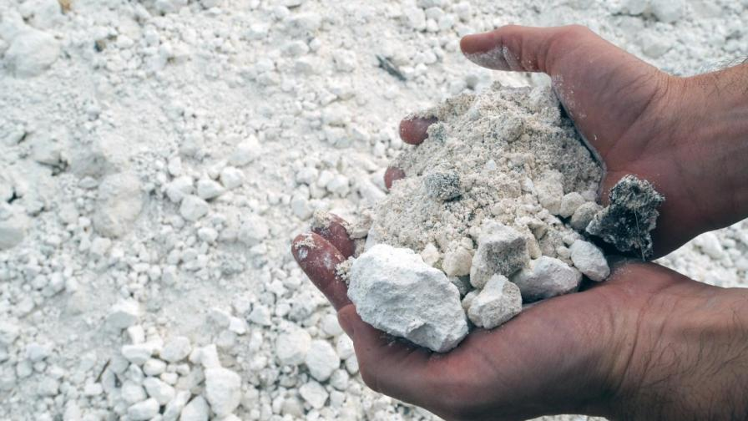

Traditional Stemming Material
Stemming Material |  | Features
Sand Stone Aggregates < 13 mm Rock Particles |  | High compression deformation ratio and porosity Limited frictional effect with hole wall
Mortar Gypsum |  | Enhanced effectiveness Significant increase in material and labor cost
Fluids like Water |  | Non-compressible and rigid motion during explosion No friction with blast hole wall

Slide 4

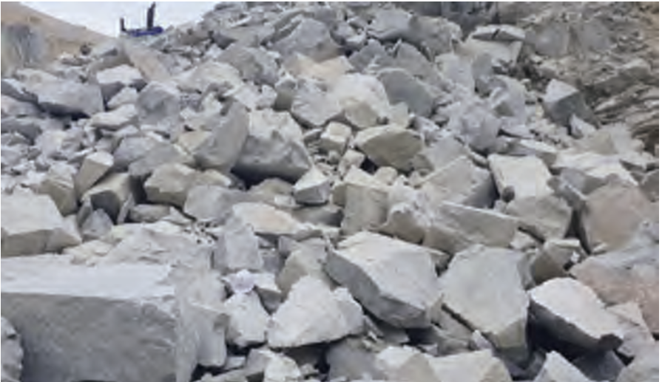
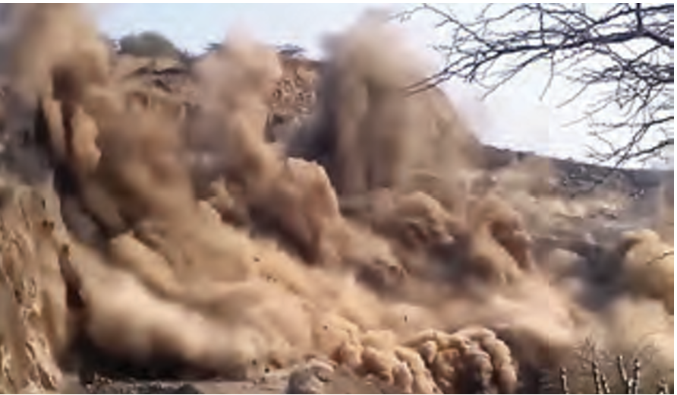
Constraints with Traditional Stemming
Blow Out Occurrence
Increased Costs due to Blasting inefficiency
Dissipation of Explosive Energy
Large compression ratio due to large number of voids
Low friction with the blast hole wall
Large rock fragments post explosions leading to increased cost of
  Primary & Secondary Breaking
  Transportation and Loading
Increased Noise and Dust
Increased amount of flying rock
Reduced crushing and digging efficiency

Slide 5
Content
Sr. No. | Description
1. | Traditional Stemming Method
2. | Smart Stem Features & Benefits
3. | Smart Stem Application
4. | Certifications & Contact Information

Slide 6
Development Motivation
Technological Advancements
Most advancements focused on development of explosives and detonators to improve safety and user convenience
Low emphasis on various secondary problems including blow-outs, poor crushing and flying rock
Blasting Efficiencies
Blasting results vary depending on variation in charging of stemming materials due to human intervention
Loss/dissipation of energy due to inadequate stemming material and low friction with hole wall can lead to over 50% energy loss during blasting

Slide 7
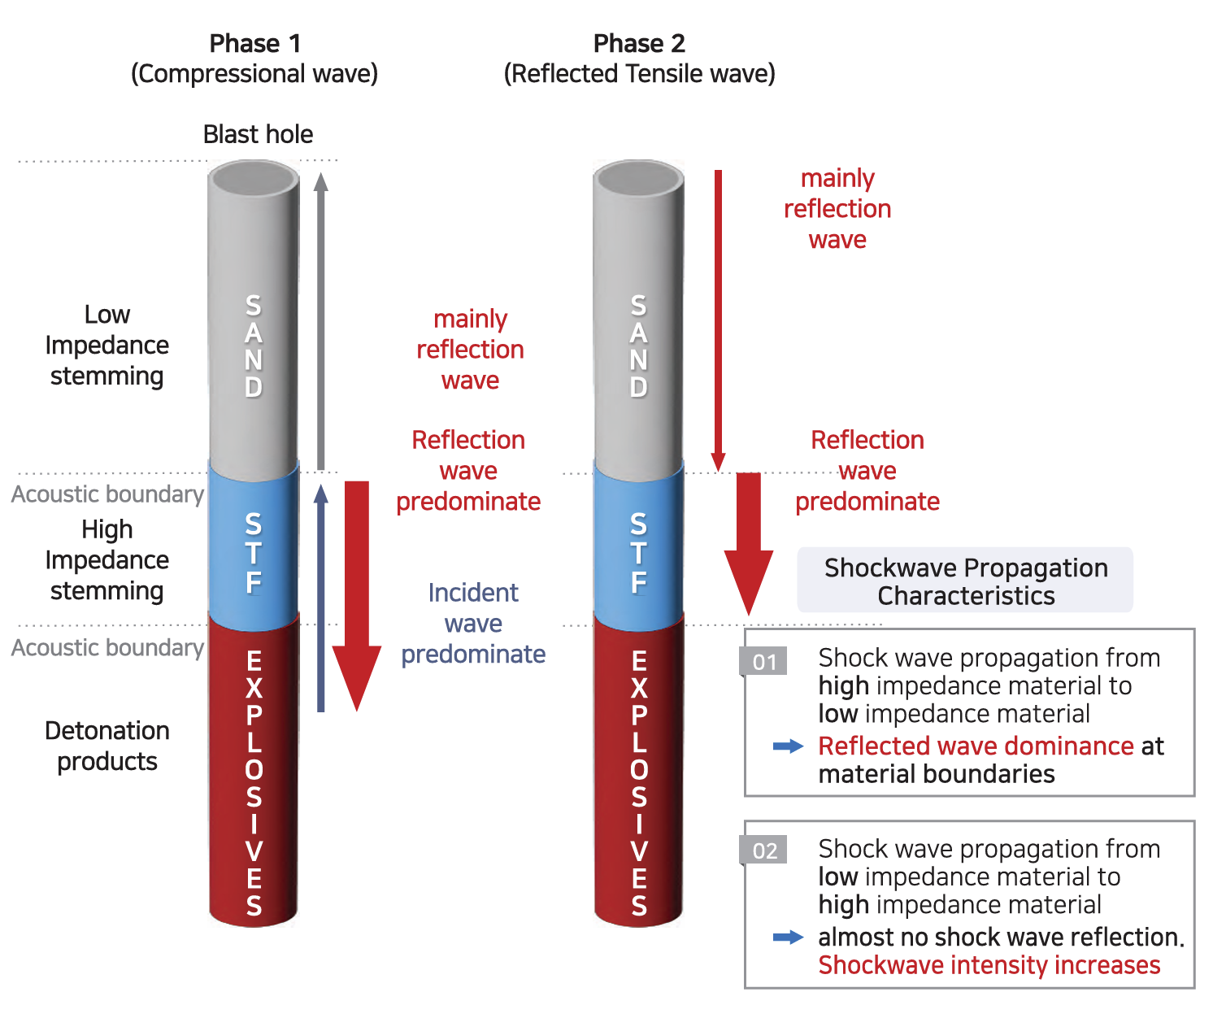
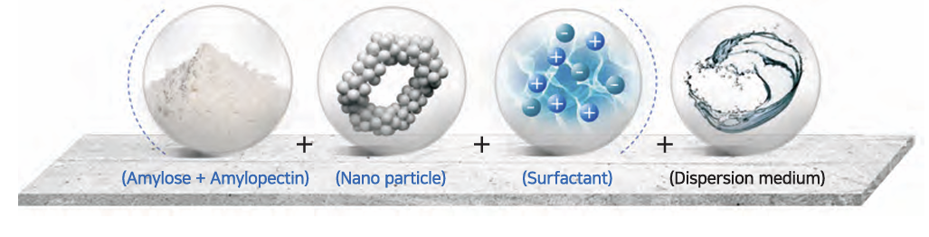
Smart Stem Features
Environment friendly fluid consisting of organic and inorganic materials filled in a vinyl tube
Contains a Shear Thickening Fluid (STF) that solidifies under pressure
Biodegradable within months under natural conditions eliminating soil and water contamination concerns
No effect of high temperature or water on the stem
Safe to use in presence of wire/shock tube
Base
Strength
Enhancer
Binder
Dispersant

Slide 8
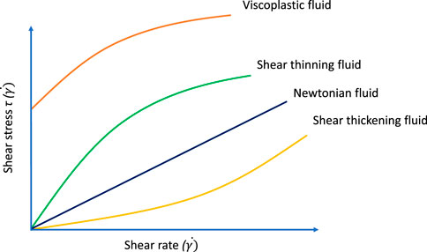
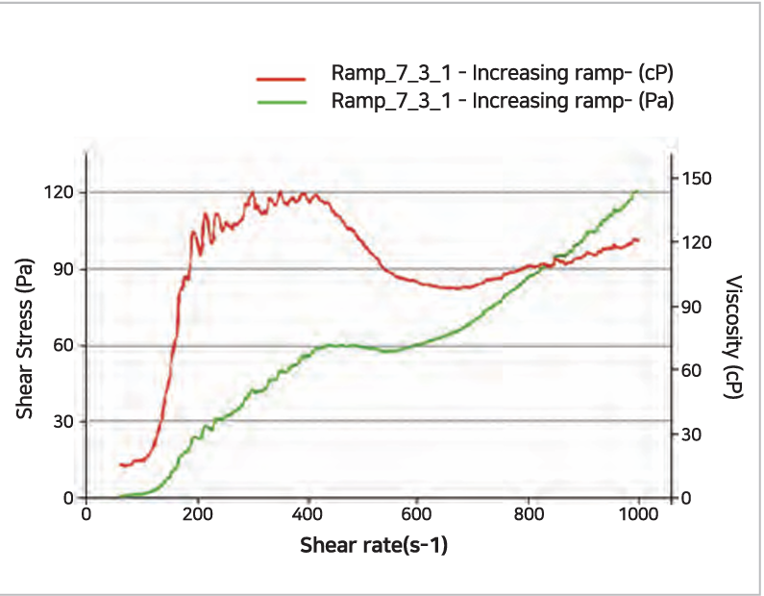
Shear Thickening Fluid
Shear-thickening fluid (STF), also known as dilatant fluid defies the usual behavior of Newtonian fluids
  Its viscosity increases as the rate of shear strain (deformation) rises i.e. when you apply force or stress to STF, it becomes thicker rather than thinner like most fluids
  At forces above critical shear rate, STF used in Smart Stem transitions from liquid state to solid state thus dissipating less energy and gas from the explosion through the drilled hole and improving effectivity

Slide 9
Smart Stem Models
Metric | Measurement Unit | SP 300* | SP 400 | SP 600
Stem Diameter | mm | 25 | 38 | 58
Stem Length | mm | 350 | 270 | 380
Stem Weight | kg | 0.22 | 0.4 | 1.3
Stem Specific Density | ton/cubic m | 1.3 | 1.3 | 1.3
Min. Drill Hole Diameter | mm | 32-40 | 45-55 | 65-75
No. of stems per box | # | 60 | 40 | 20
Key Features
Smart Stems work for Drill Hole Depth up to 20 m
SP 800 with 83 mm diameter suitable for 90-110 mm drill hole diameter under development
Shelf Life of 1 year
To be stored between (-10 ˚C) – 35 ˚ C
SP300* : Stem specifications to be confirmed

Slide 10
Smart Stem Benefits
Blasting Efficiency
Prevents/eliminates blow-out
Eliminates flying rock/debris
Reduces energy dissipation through hole due to solidification of STF
Increases fracture improvement rate by amplifying explosive gaseous energy
Environmental Impact
Reduces urban blasting vibrations by up to 50%
Reduces noise /dust
Biodegradable under natural conditions
No water / soil pollution from Smart Stem
Cost Saving
Increases blasting productivity by 10-15%
Reduces granularity of fractured rock and thus reduced secondary crushing expenses by up to 30%
Crusher Efficiency also increased by 20-30% due to smaller rock fragments
Smart Stem helps reduce overall costs (blasting and crushing) by up to 15-20%

Slide 11
Content
Sr. No. | Description
1. | Traditional Stemming Method
2. | Smart Stem Features & Benefits
3. | Smart Stem Application
4. | Certifications & & Contact Information

Slide 12
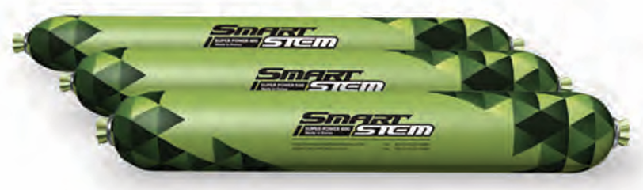
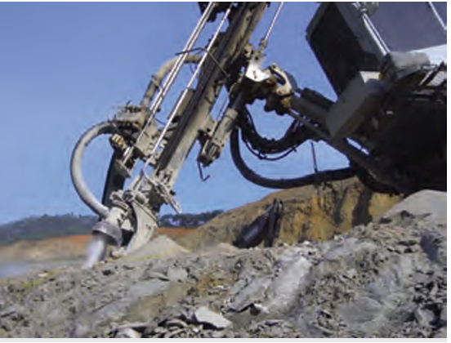
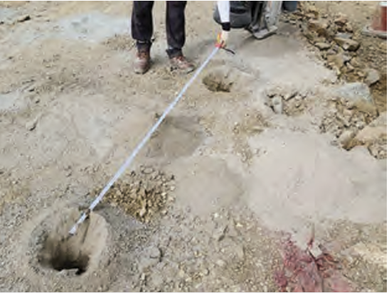
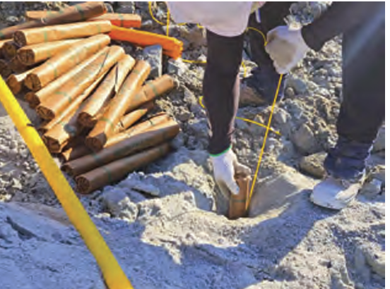
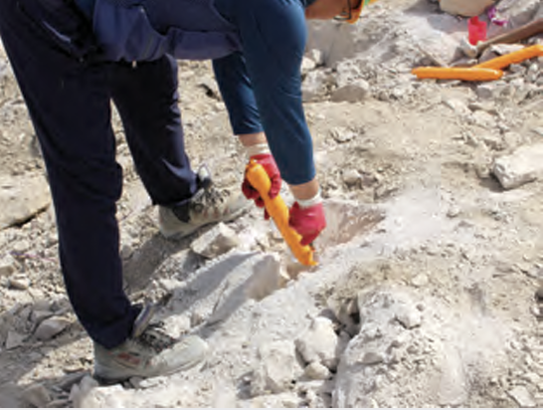
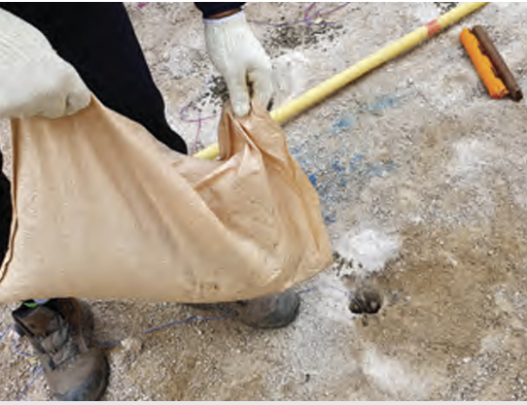
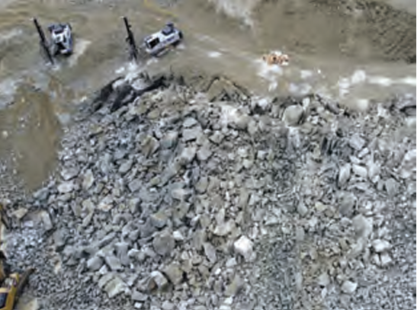
Smart Stem Application
Drilling
Charging
Smart Stem
General Stemming
Connecting
Blasting
Muckfile
Supporting
Hybrid Stemming
Drilling
According to blasting parameters (diameter and depth)
Inspections for Perforations
Charging
Loading explosives into the drilled holes
Insert Start Stem
Single or combination of stems to be used depending on hole diameter and depth
Hybrid Stemming
Insert conventional stemming material in remaining part
Blasting
Conducting perimeter control and blasting

Slide 13
Content
Sr. No. | Description
1. | Traditional Stemming Method
2. | Smart Stem Features & Benefits
3. | Smart Stem Application
4. | Certifications & Contact Information

Slide 14
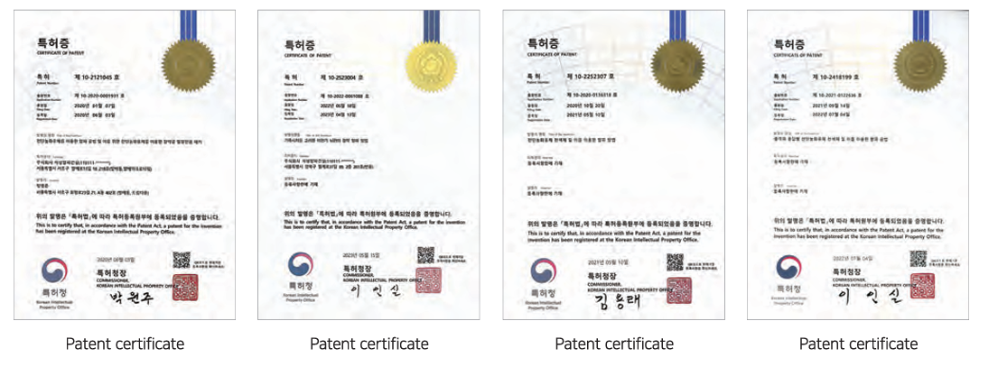
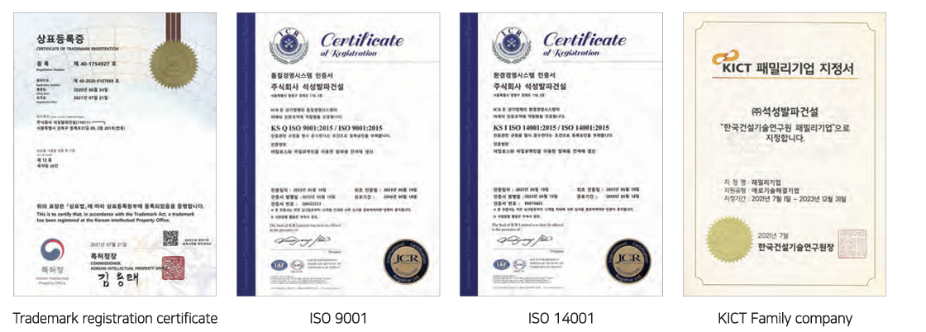
Certifications

Slide 15
Contact Information
Sumul Patel sumul.patel@dattatreyainc.com
M: +919824049872
Yash Patel yashpatel.2910@outlook.com
M: +916353927986

