Slide 1
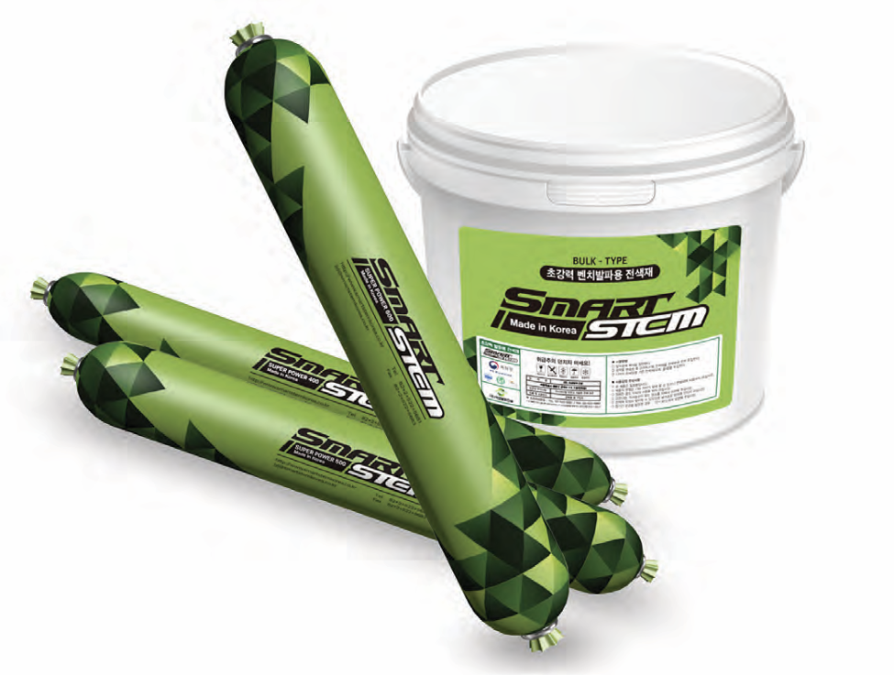
SMART STEM
Revolutionizing Bench & Tunnel Blasting through Innovative Stemming
x

Slide 2
Content
Sr. No. | Description
1. | Traditional Stemming Method
2. | Smart Stem Features & Benefits
3. | Smart Stem Application
4. | Certifications & Contact Information

Slide 3
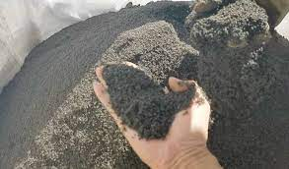
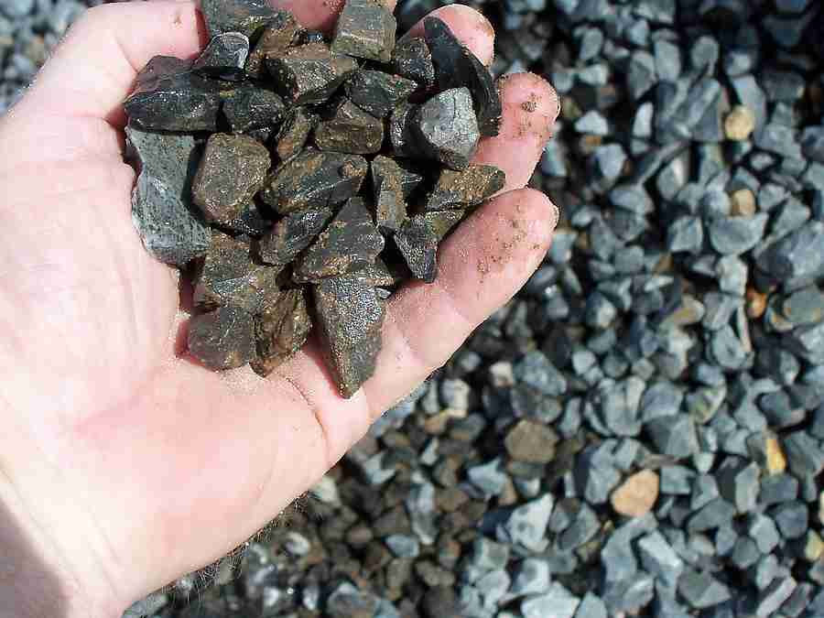
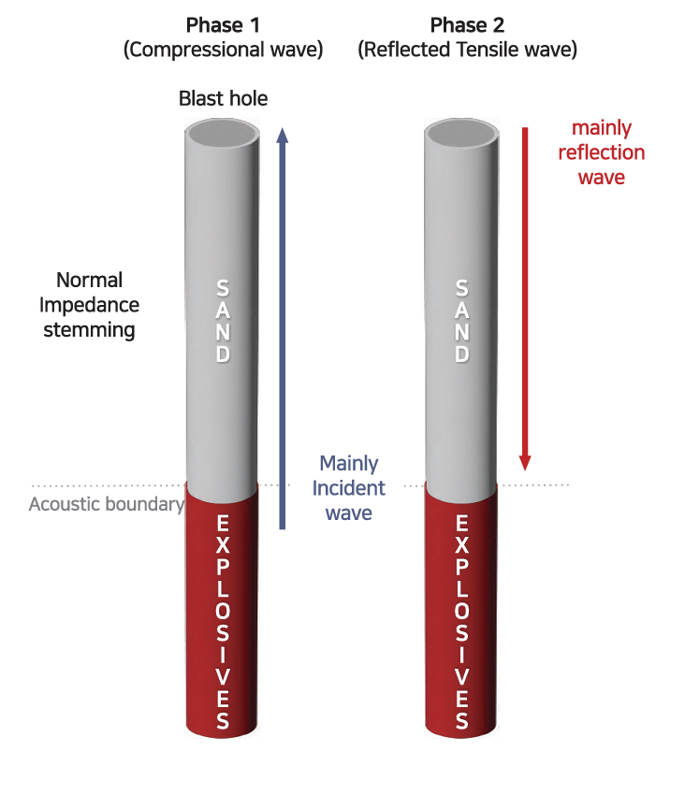
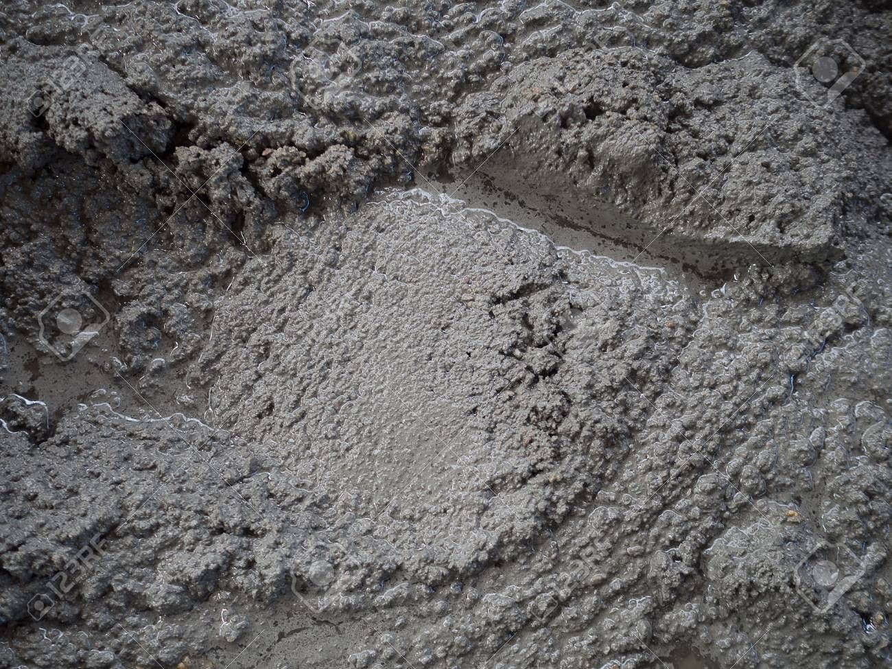
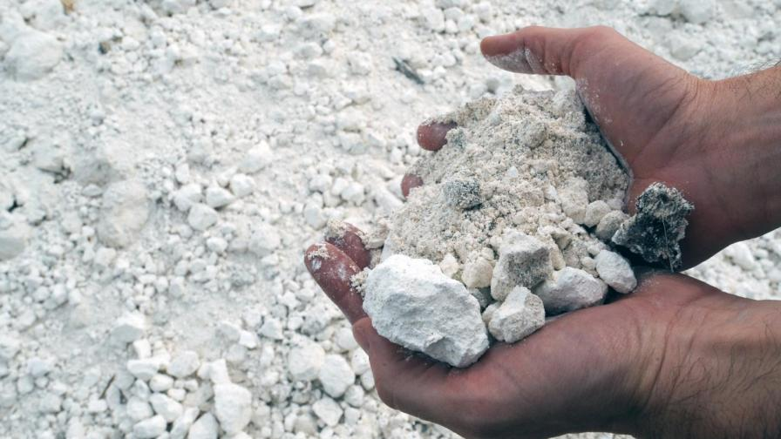
Traditional Stemming Material
Stemming Material |  | Features
Sand Stone Aggregates < 13 mm Rock Particles |  | High compression deformation ratio and porosity Limited frictional effect with hole wall
Mortar Gypsum |  | Enhanced effectiveness Significant increase in material and labor cost
Fluids like Water |  | Non-compressible and rigid motion during explosion No friction with blast hole wall

Slide 4
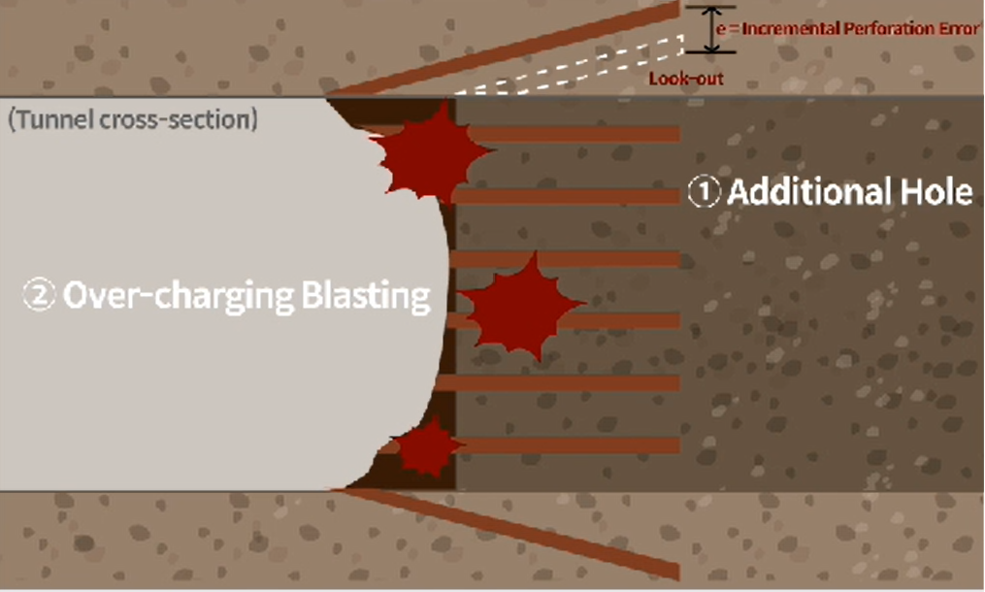
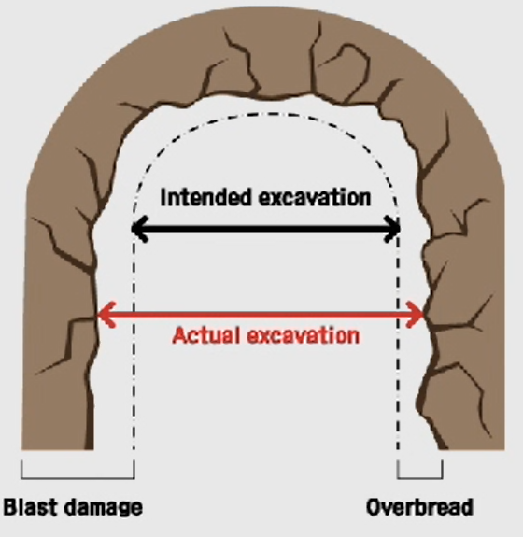
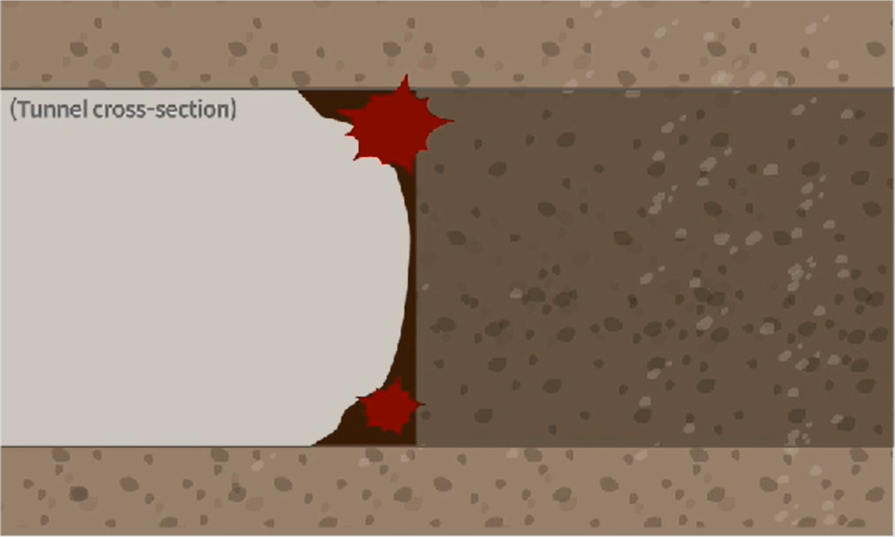
Constraints with Traditional Stemming
Drilling Additional Holes to maintain cycle time due to occurrence of unexcavated area from poor excavation rate
Secondary Blasting of unexcavated area from poor excavation rate
Key Constraints
Increase in the no. of perforation holes with additional extended perforations
Increase in perforation error in the cavity of look out hole
Expansion of the drilling field beyond the design pattern
Loud noises and vibrations from over-charged blasting
Damage to surrounding bed-rock
Key Constraints
Disturbance in cycle time
Increase in overheads due to longer project timeline

Slide 5
Content
Sr. No. | Description
1. | Traditional Stemming Method
2. | Smart Stem Features & Benefits
3. | Smart Stem Application
4. | Certifications & Contact Information

Slide 6
Development Motivation
Technological Advancements
Most advancements focused on development of explosives and detonators to improve safety and user convenience
Low emphasis on various secondary problems including blow-outs, poor crushing and flying rock
Blasting Efficiencies
Blasting results vary depending on variation in charging of stemming material and perforation dynamics due to human intervention
Loss/dissipation of energy due to inadequate stemming material and low friction with hole wall can lead to over 50% energy loss during blasting

Slide 7
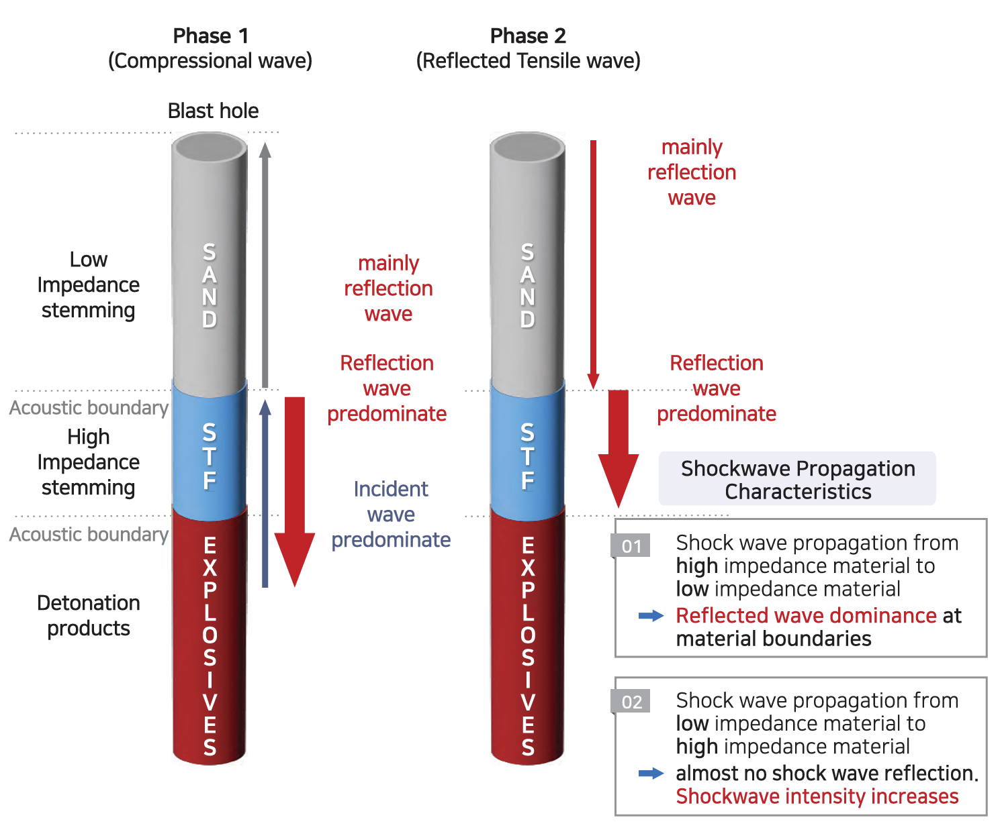
Smart Stem Features
Environment Friendly fluid consisting of organic and inorganic materials
Contains a Shear Thickening Fluid (STF) that solidifies under pressure
Biodegradable within months under natural conditions eliminating soil and water contamination concerns
No effect of high temperature or water on the stem
Safe to use in presence of wire/shock tube
Base
Strength
Enhancer
Binder
Dispersant

Slide 8
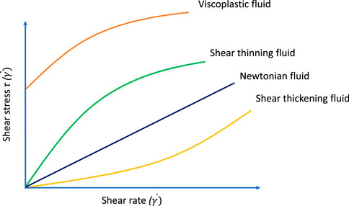
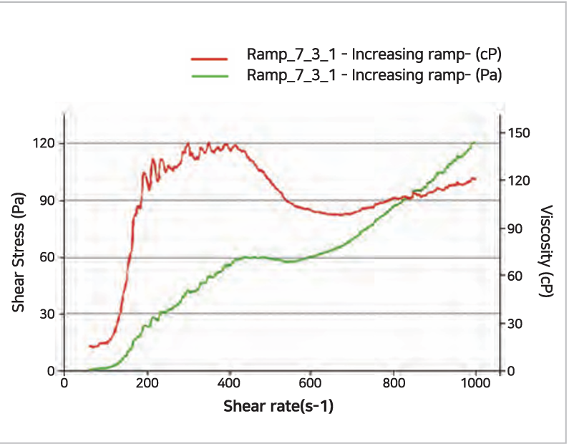
Shear Thickening Fluid
Shear-thickening fluid (STF), also known as dilatant fluid defies the usual behavior of Newtonian fluids
Its viscosity increases as the rate of shear strain (deformation) rises i.e. when you apply force or stress to STF, it becomes thicker rather than thinner like most fluids
At forces above critical shear rate, STF used in Smart Stem transitions from liquid state to solid state thus dissipating less energy and gas from the explosion through the drilled hole and improving effectivity

Slide 9
Smart Stem Models
Metric | Measurement Unit | SP 300* | SP 400 | SP 600
Stem Diameter | mm | 25 | 38 | 58
Stem Length | mm | 350 | 270 | 380
Stem Weight | kg | 0.22 | 0.4 | 1.3
Stem Specific Density | ton/cubic m | 1.3 | 1.3 | 1.3
Min. Drill Hole Diameter | mm | 32-40 | 45-55 | 65-75
No. of stems per box | # | 60 | 40 | 20
Key Features
Smart Stems work for Drill Hole Depth up to 20 m
SP 800 with 83 mm diameter suitable for 90-110 mm drill hole diameter under development
Shelf Life of 1 year
To be stored between (-10 ˚C) – 35 ˚ C
SP300* : Stem specifications to be confirmed

Slide 10
Smart Stem Benefits
Blasting Efficiency
Reduced the frequency and occurrence of unexcavated area
Helps Maintain the intended design and excavation patterns
Maintain Cycle time
Reduces perforation error in the look-out cavity
Minimizes damage area of bed rock
Cost Saving
10% increase in controlled blast field excavation reduces direct construction cost by up to 4 %
Construction duration decreases by up to 10 %
Secondary non-vibratory excavation costs would reduce by up to 25%
Smart Stem helps reduce overall construction costs by up to 20%

Slide 11
Content
Sr. No. | Description
1. | Traditional Stemming Method
2. | Smart Stem Features & Benefits
3. | Smart Stem Application
4. | Certifications & Contact Information

Slide 12
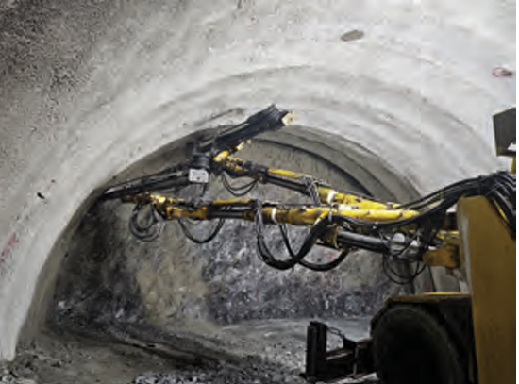
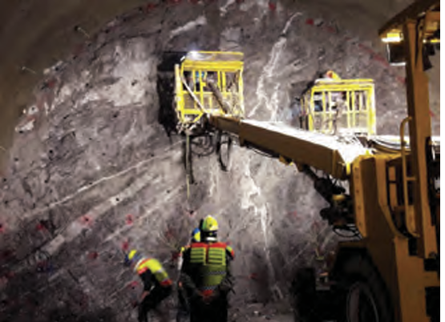
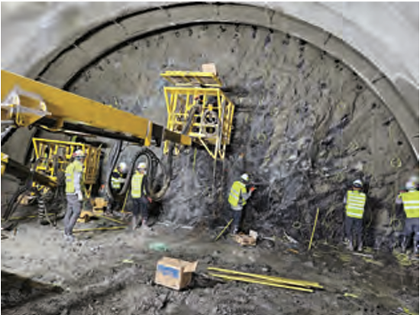
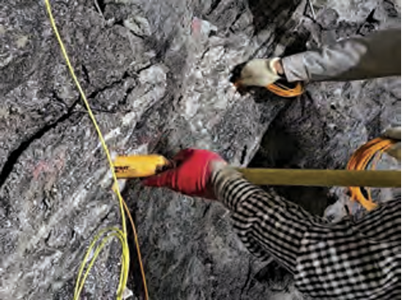
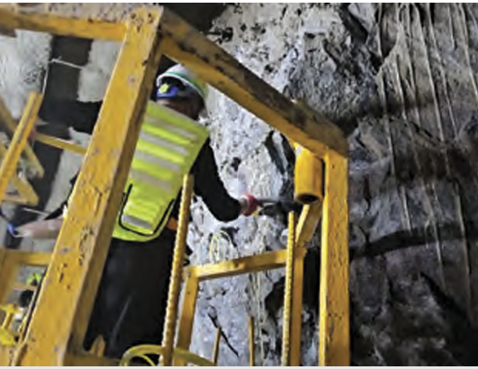
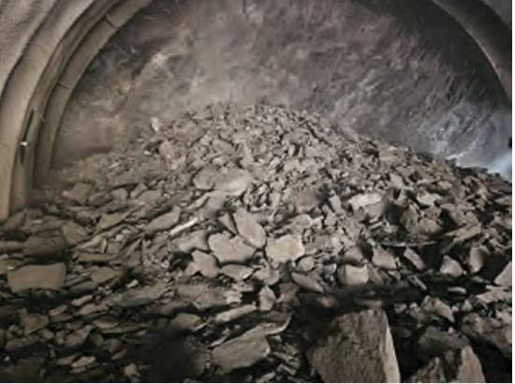
Smart Stem Application
Perforation
Charging
Smart Stem
General Stemming
Wiring
Blasting
Muck Pile
Re-inforcements
Hybrid Stemming
Perforations
According to blasting parameters (diameter and depth)
Inspections for Perforations
Charging
Loading explosives into the drilled holes
Insert Start Stem
Single or combination of stems to be used depending on hole diameter and depth
Hybrid Stemming
Insert conventional stemming material in remaining part
Blasting
Conducting perimeter control, water checking & blasting

Slide 13
Content
Sr. No. | Description
1. | Traditional Stemming Method
2. | Smart Stem Features & Benefits
3. | Smart Stem Application
4. | Certifications & Contact Information

Slide 14
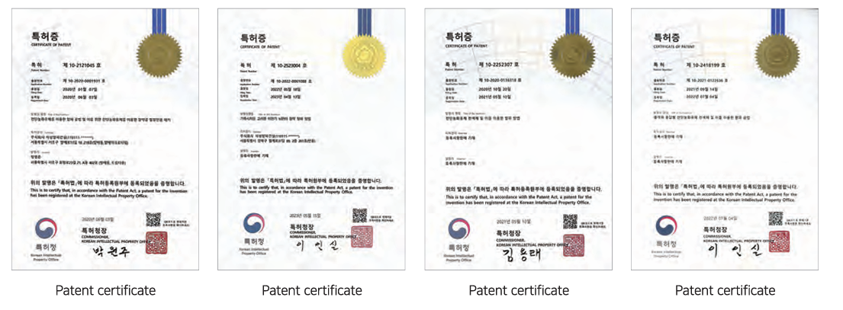
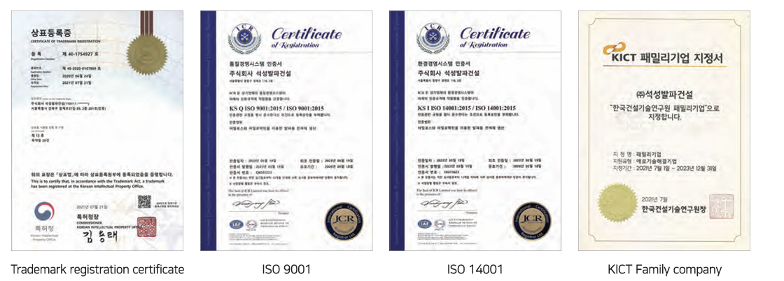
Certifications

Slide 15
Contact Information Sumul Patel sumul.patel@dattatreyainc.com M: +919824049872 Yash Patel yashpatel.2910@outlook.com M: +916353927986

